Slide 1

Presented by Andrew Halley - Convener
Hobart – 15/11/2018

Slide 2
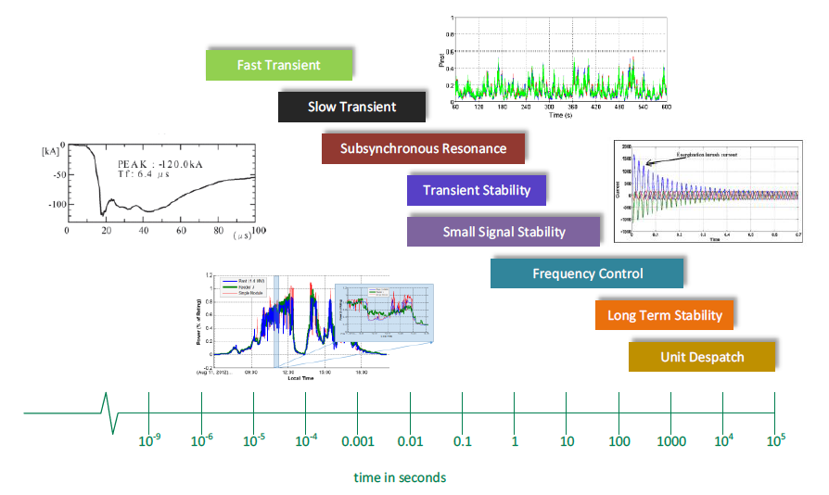
SC C4 - Scope
Power quality
Electromagnetic Compatibility and Interference (EMC/EMI)
Insulation Co‐ordination
Lightning
Power Systems Dynamics and Numerical Analysis
ATC Seminar 2018

Slide 3
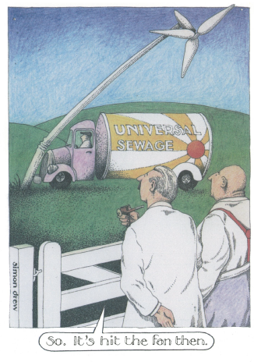
2018 Paris Session
Highlight #1:
The role of distribution and transmission operators?
  Question from audience member during C2 Meeting.
  “Who is looking after overall grid stability?”
  Concept of joint planning and information sharing now being openly discussed as issues for many countries.
  Raises a further question: Who has all the information necessary to manage overall grid stability?
  Modelling and performance management of distributed (embedded) energy resources is already a very significant issue which will continue to develop.
  Australia is well aware of the issues and has commenced with the development of some practical solutions, e.g. ARENA project to develop an improved composite load model inclusive of PV characteristics.
ATC Seminar 2018

Slide 4
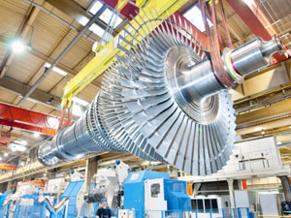


2018 Paris Session
Highlight #2:
Global realisation that inertia and system strength are significant issues.
  The need for and specification of synchronous condensers is being actively talked about. An almost defunct technology is now seeing a resurgence!
  Frequency control and managing rate of change of frequency (ROCOF) are being seen as issues requiring appropriate consideration, even on continental Europe.
  How to deliver frequency control services from solar and wind farms has become a mainstream topic.
  The use of energy storage technologies (batteries and super capacitors) to supplement generation based frequency control is an idea gaining traction.
  Again, Australia is at the forefront (if not leading) developments in some of these areas, e.g. Hornsdale Power Reserve.
Not all MW are equal!
ATC Seminar 2018

Slide 5
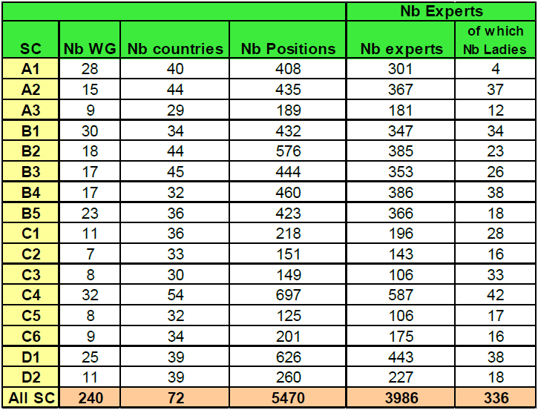
2018 International Activities
SC C4 Working Groups (WG)
  WGs are the ‘engine room’ of CIGRE.
  At August 2018, 29 WGs involving study committee (SC) C4.
  Breakdown by sub-topic:
Power quality, 4
Electromagnetic Compatibility and Interference (EMC/EMI), 4
Insulation Co‐ordination, 5
Lightning, 6
Power Systems Dynamics and Numerical Analysis, 10
  Increasing dominance of inverter connected renewable energy systems is driving significant activity in C4.
  Australia has representatives on eight (8) WG’s at present.
Stats at end of 2017:
C4 had the highest number of people on WGs
C4 had the most women on WGs.
ATC Seminar 2018

Slide 6

2018 International Activities
Examples of WGs with direct relevance for Australia
WG C4.23 Guide to procedures for estimating the lightning performance of transmission lines
WG C4.44 EMC for large photovoltaic systems
WG C4.47 Power system resilience
JWG C4/B4.38 Network modelling for harmonic studies.
JWG A1/C4.52 Wind generators and frequency-active power control of power systems.
JWG B5/C4.61 Impact of low inertia network on protection and control.
JWG C2/C4.41 Impact of high penetration of inverter-based generation on system inertia of networks.
ATC Seminar 2018

Slide 7

2018 International Activities
Green Books (in progress)
  Are the CIGRE flagship reference, intended to describe the ‘state of the art’.
  “Electricity Supply Systems of the Future”
    C4 will provide a complete section on foreseeable and potential system technical performance issues.
    Australian input to Chapter 13 “System Dynamics”.
    Publication is due in August 2020.
  “FACTS Devices”
    Publication is being led by SC B4
    C4 providing specific technical input on “Commissioning tests for FACTS devices” (chapter lead is from Australia!).
ATC Seminar 2018

Slide 8
2018 International Activities
Significant upcoming events
CIGRE Symposium 2019 (3-6 June), Aalborg, Denmark,
  “Going Offshore – Challenges of the future power grid”
  C4 is the lead Study Committee.
  Receipt of abstracts has now closed.
  Aware (so far) of one abstract accepted from Australia.
  “Procurement of pumped storage system strength services to increase the hosting capacity of non-synchronous generation: A Tasmanian Case Study”
  Submitted by Christopher Wembridge (Hydro Tasmania) and Daniel Fracalossi (TasNetworks).
Event includes a one day tour of the ANHOLT offshore wind farm.
ATC Seminar 2018

Slide 9
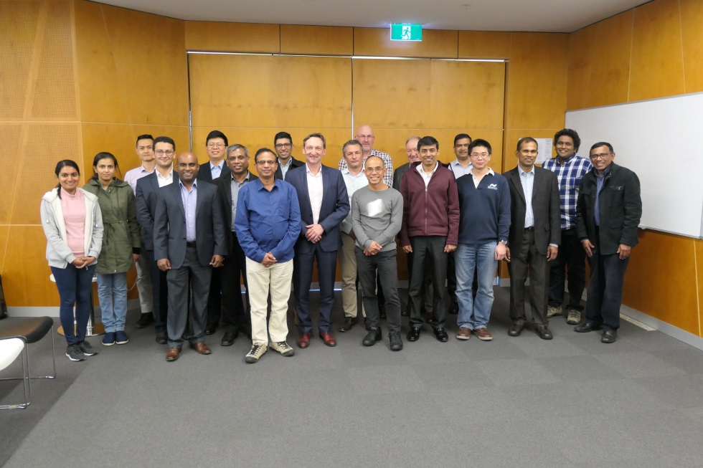
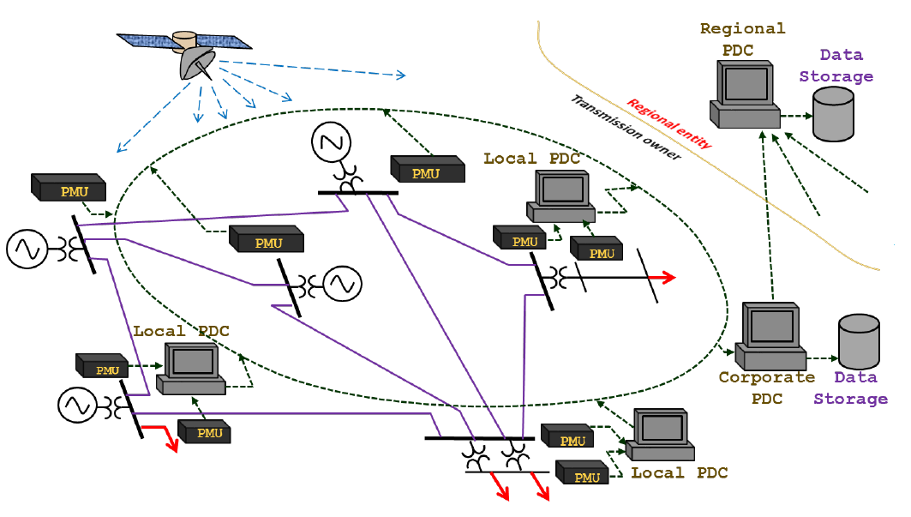
2018 AU/NZ Activities
AU-C4 Technical Seminar – 13/14 August 2018
“Application of synchrophasor solutions for the monitoring and control of power systems”
  Held at the University of Wollongong, Innovation Campus.
  Fortunate to obtain the support of three international guest speakers from the University of Manitoba and Teshmont (Canada).
  Based on CIGRE Technical Brochure 702
  The course covered technical fundamentals together with practical applications of Phasor Measurement Units (PMU) and associated technologies including communication systems.
ATC Seminar 2018

Slide 10

2018 AU/NZ Activities
Knowledge and learnings in
Paris General Session 2018
  Five papers accepted and presented in Paris.
  Notable interest observed during SC C4 Poster Session.
Ongoing contributions to WG and other industry activities
  Nineteen (19) CIGRE Australia members are represented on active C4 WG.
    Have implemented a ‘shadow working group’ for C2/C4.41 due to the level of interest from Australia.
    “Impact of high penetration of inverter based generation on system inertia of networks”.
  AU C4 members are actively involved in preparation of two ‘Green Books’
  AU C4 members continue to support the work of Standards Australia and the International Electrotechnical Commission (IEC).
CIGRE Australia
Knowledge and learnings out
(our experiences)
ATC Seminar 2018

Slide 11
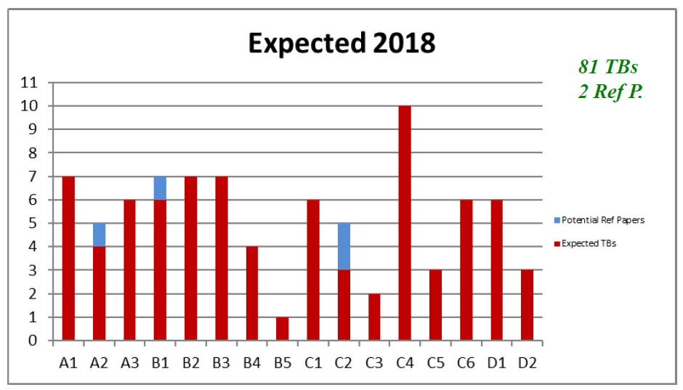
2018 Deliverables
Technical Brochures (Published in 2018)
TB 716: System conditions for and probability of out-of-phase.
TB 718(*): Benchmarking of power quality performance in transmission systems.
TB 719: Power quality and EMC issues associated with future electricity networks.
TB 727(*): Modelling and dynamic performance of inverter based generation in power system transmission and distribution studies.
TB 736: Power system test cases for EMT type simulation studies.
TB 742: (C2/C4 JWG) A proposed framework for coordinated power system stability control
Technical Brochures (Imminent)
TB 7XX(*): Understanding of the geomagnetic storm environment for high voltage power grids.
Planned Technical Brochure Publications for 2018
(*) indicates AU-C4 involvement
ATC Seminar 2018

Slide 12

2018 Deliverables
CIGRE Science and Engineering Journal
The journal is intended to broaden CIGRE’s publication of scientific articles of interest to members and industry.
Access to the CSE Journal is ABSOLUTELY FREE! @ https://e-cigre.org
June 2018: Joint Publication, SC C4 and C2 (*)
“Effects of increasing power electronics based technology on power system stability: Performance and operations”
Throughout 2017, ten C4 related papers were published.
Expect at least this number by close of 2018, some examples:
System inertia and Rate of Change of Frequency (RoCoF) with increasing non-synchronous renewable energy penetration.
Providing primary frequency response from photovoltaic power plants.
Analysis of reduced order models representing active distribution grids in power system stability studies.
Relevant to Australia? Absolute no brainer!
ATC Seminar 2018

Slide 13
Thankyou and please enjoy your stay in Hobart.
Andrew Halley, AU C4 Convenor
ATC Seminar 2018

