Slide 1
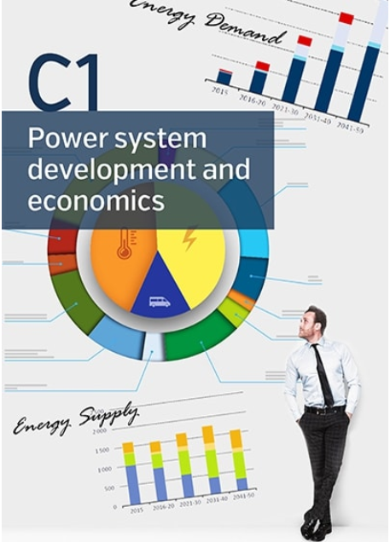
Presented by Graeme Ancell - Convener
Hobart – 15/11/2018

Slide 2
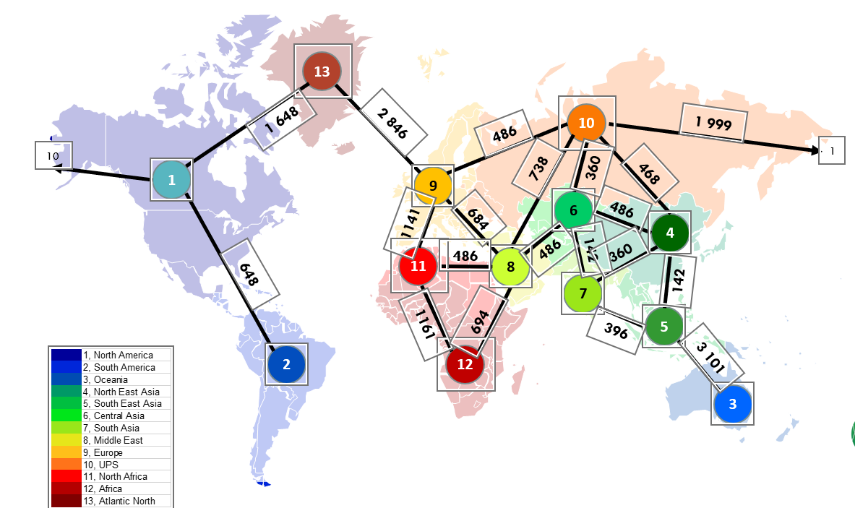
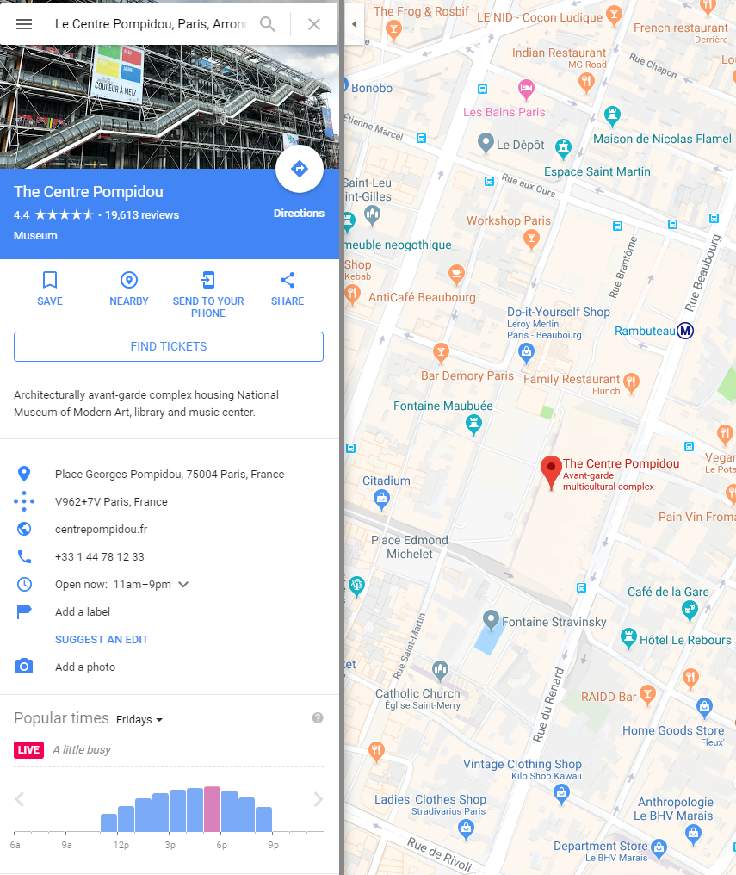
2018 Paris Session
SC C1 tutorial on the pre-feasibility study of a global electricity network
Cigre is the only organisation with the global reach to be able to develop the input data needed for such a study.
The working group includes 27 power system planning experts coming from 17 countries covering all the continents.
Forecasting mobile electricity demand
Paper on “Using SMARTPHONE GPS data to characterise Destination EV charging demand”
NZ: EV demand at new inland port
Heavy transport hub?
Long distance travellers?
Inland Port Staff?
ATC Seminar 2018

Slide 3
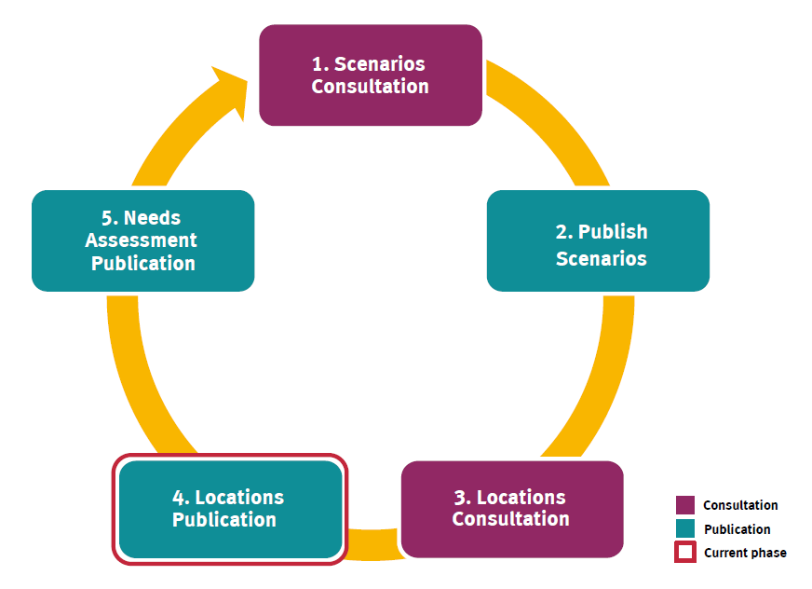
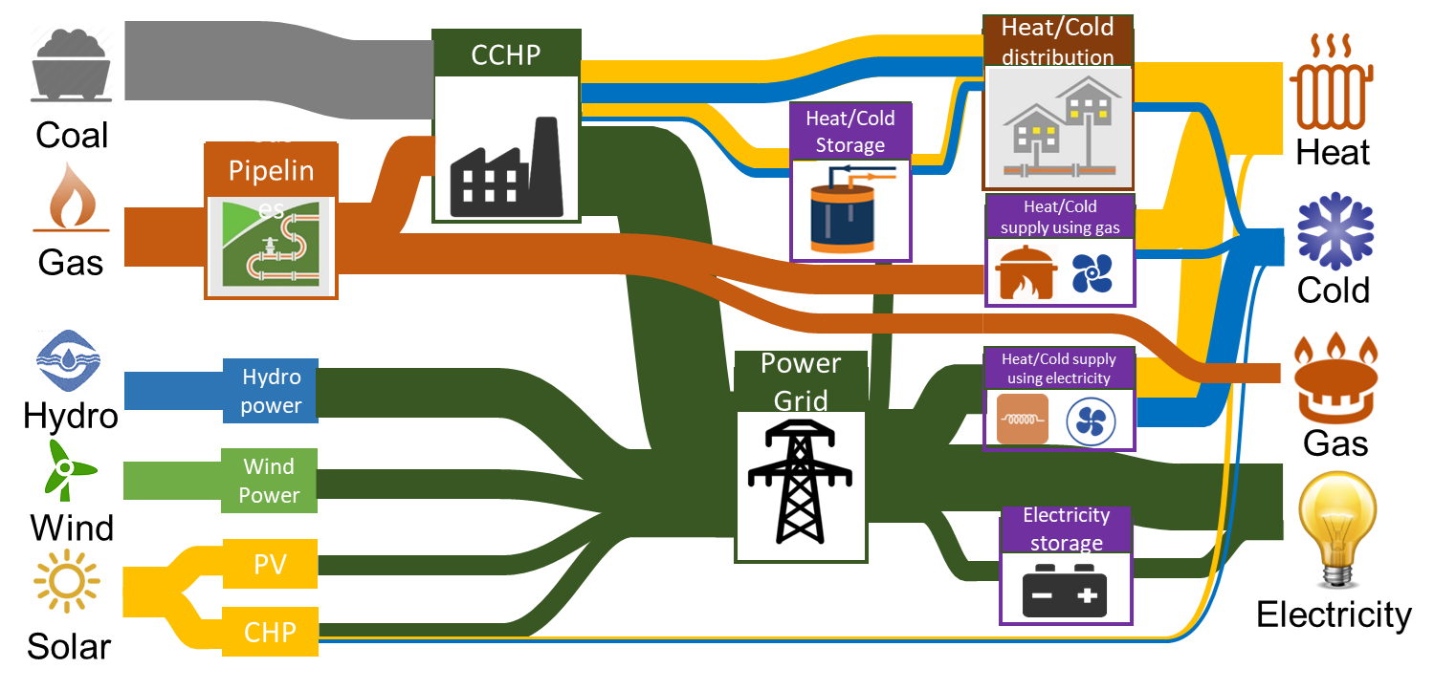
2018 Paris Session
Importance of Stakeholder consultation
Several countries reported Instances where consultation provided unexpected benefit
NZ: Stakeholders concerned with fault levels for grid reconfiguration
Coordinated planning across multiple energy systems
Chinese presentation
Relevant for decarbonisation strategies
ATC Seminar 2018

Slide 4
2018 International Activities
Green Book on Asset Management underway
Graeme Ancell is a co-editor
NZ contributors
Looking for Australian case studies in general and for aging assets specifically
Future working groups (in development)
Follow-up from C1.35 (Global Electricity Network)
Review evolving existing and new expansion planning tools to include the value of distributed generation and customer flexibility
Methods to extract the value from high penetration of EVs, customer storage and demand response
Requirements for asset analytic systems
ATC Seminar 2018

Slide 5
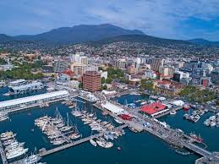
2018 AU/NZ Activities
AUC1 Meeting in Hobart this week
Australian/New Zealand participation
WG C1.22: Investment decisions in a changing and uncertain environment – Cynthia Liu
WG C1.23: Transmission Investment Decision Points and Trees - Graeme Ancell
WG C1.34: ISO Series 55000 Standards: General Process Assessment Steps and Information Requirements for Utilities – Marshall Brenton
WG C1.38: Valuation as a comprehensive approach to asset management in view of emerging development
WG C1.39: Optimal power system planning under growing uncertainty -Herath Samarakoon, Christian Schafer
Green Book on Asset Management
ATC Seminar 2018

Slide 6
2018 Deliverables
Upcoming Technical Brochures
WG C1.22: New investment decision processes and regulatory practices required to deal with changing economic drivers (Dec 18)
WG C1.23: Transmission investment decision points and trees management in view of emerging development (Early 19)
WG C1.33: Interface & Allocation Issues in multi-party and/or cross-jurisdiction power infrastructures projects (Dec 19)
WG C1.34: ISO Series 55000 Standards: General Process Assessment Steps and Information Requirements for Utilities (May 19)
WG C1.35: Global electricity network feasibility study (May 19)
WG C1/C4.36: Review of the Metropolitan area power system development trends taking into account new generation, grid and information technologies ( Oct 19)
WG C1.38: Valuation as a comprehensive approach to asset (Jun 19)
WG C1.39: Optimal power system planning under growing uncertainty (End 2019)
ATC Seminar 2018

