Slide 1
Presented by Greg Hesse- Convener
Hobart – 15/11/2018

Slide 2
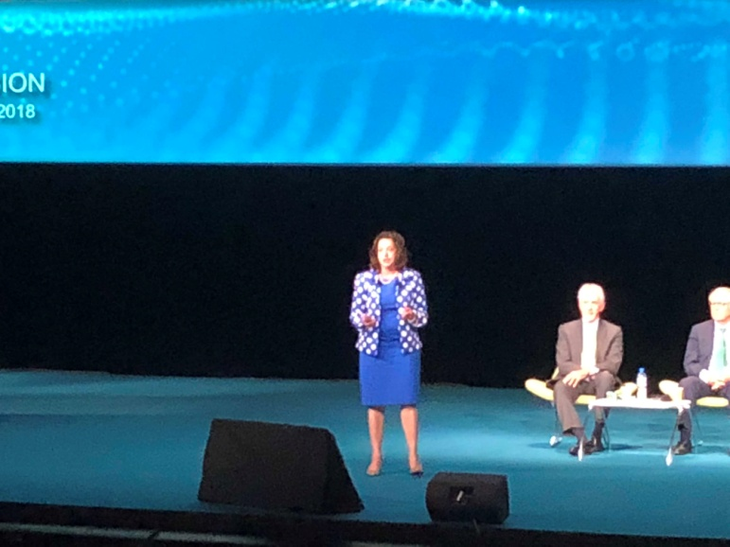
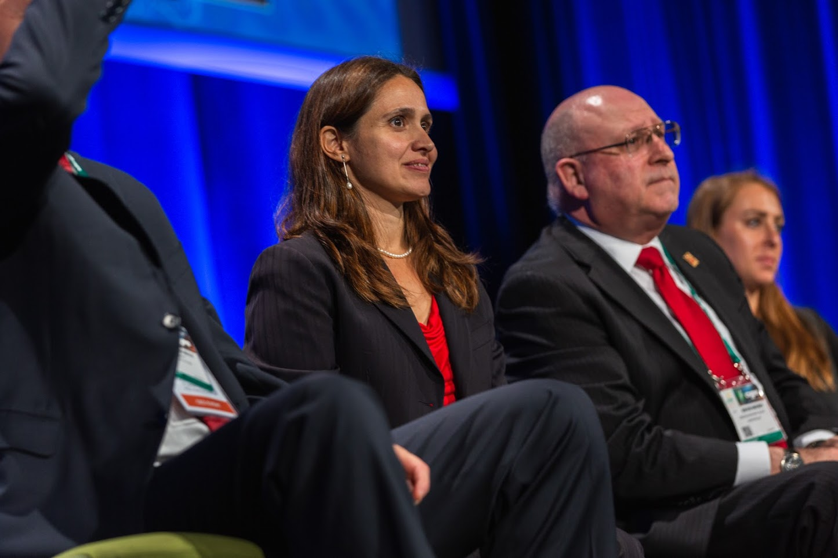
2018 Paris Session
Opening Address by Audrey Zibelman (AEMO)
Huge changes being seen across most aspects of the power system
The power system is becoming a platform for consumers to transact across, not just be passive recipients of a service
Australia is a postcard from the future
Large Disturbance Workshop
South Australia blackout provided insights into both technical learnings from the event, and the policy and market repercussions as well
Having both aspects of the same event presented was commented on favourably
Picture/graphic for highlight 2
ATC Seminar 2018

Slide 3
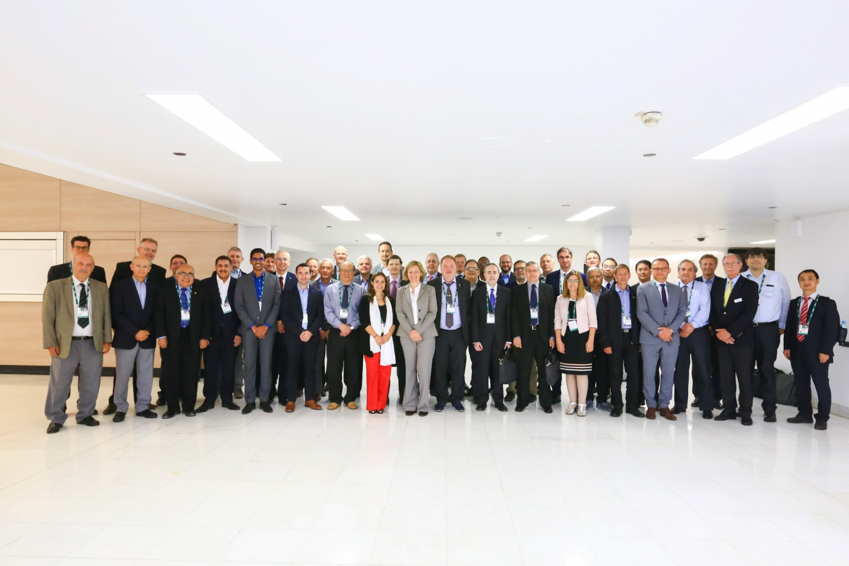
2018 International Activities
C2 Group Discussion Meeting
45 papers with over 360 attendees
Key themes of relevance to Australia
Improving operations across TSO/DSO boundaries
Changing operational responses under reduced inertia conditions
Applications of PMUs to assist operational actions
C2 Tutorial on TSO/DSO interaction and co-ordination
Over 250 attendees
ATC Seminar 2018

Slide 4
2018 AU/NZ Activities
A focus has been getting more AP C2 members involved in WG activities
Each new WG this year has a different Australian participant
Technology now facilitates greater level of participation than previously – but timezones remain a challenge
Panel meeting was held in Adelaide on 16 October
Increasing involvement from DNSPs
In 2019 will be looking for opportunities for joint activity with other Panels
ATC Seminar 2018

Slide 5
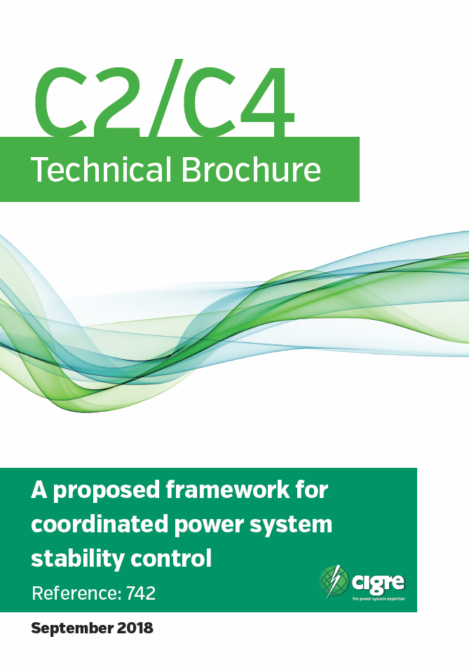
2018 Deliverables
Technical Brochures
TB712 – System Restoration Procedure and Practices (WG C2.23)
TB732 – Advanced Utility Data Management and Analytics for Improved Operation Situational Awareness of EPU Operations (JWG D2/C2.41
TB733 – System Operation Emphasising DSO/TSO Interaction and Coordination (JWG C2/C6.36)
TB742 – A Proposed Framework for Coordinated Power System Stability Control (JWG C2/C4.37)
ATC Seminar 2018

