Slide 1
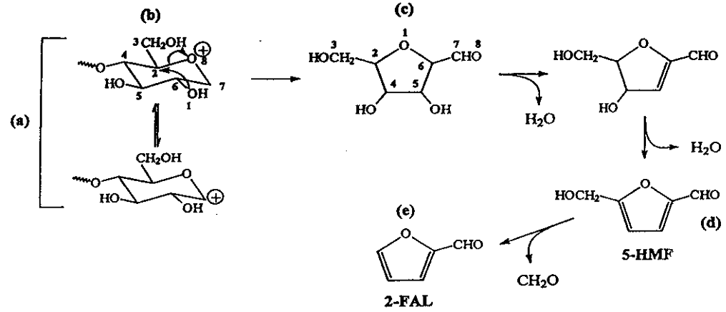
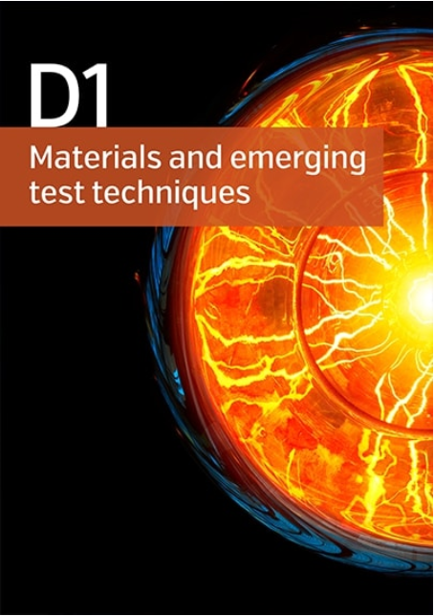
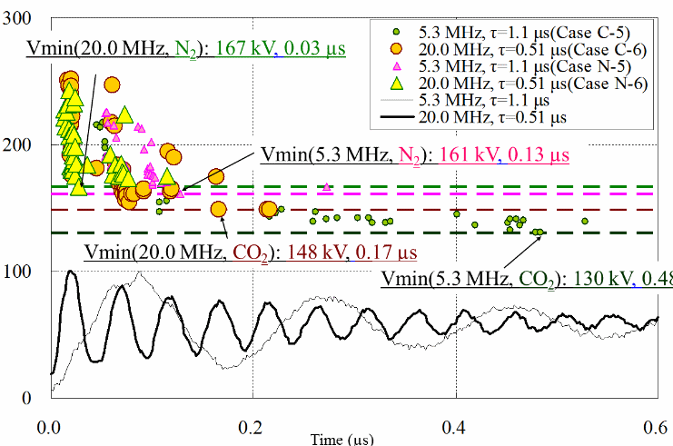
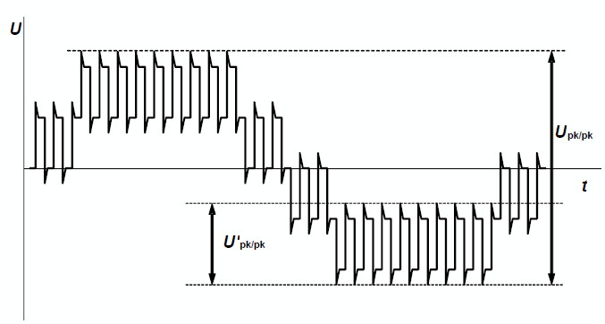
Presented by Joe Tusek - Convener
Hobart – 15/11/2018

Slide 2
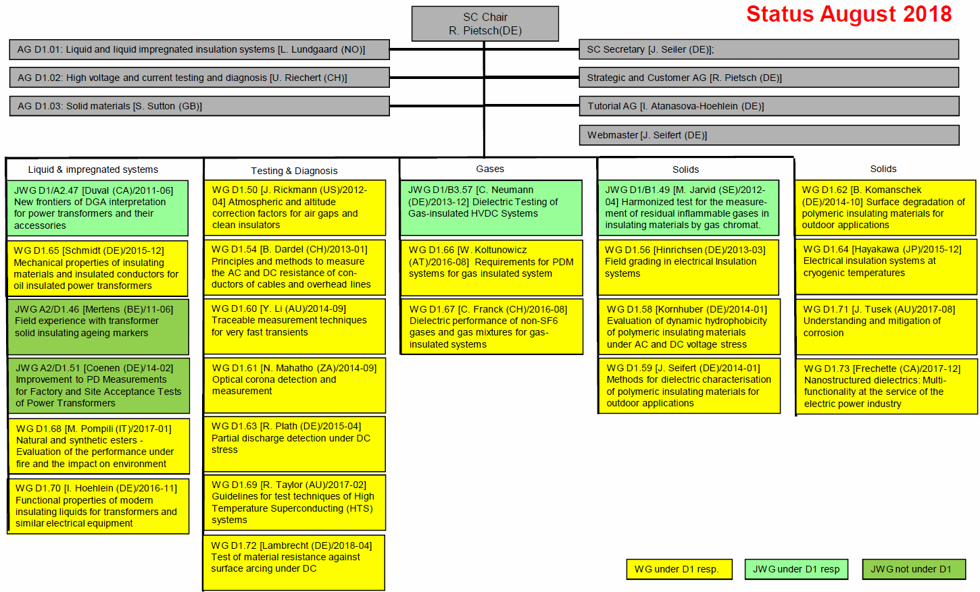
ATC Seminar 2018

Slide 3
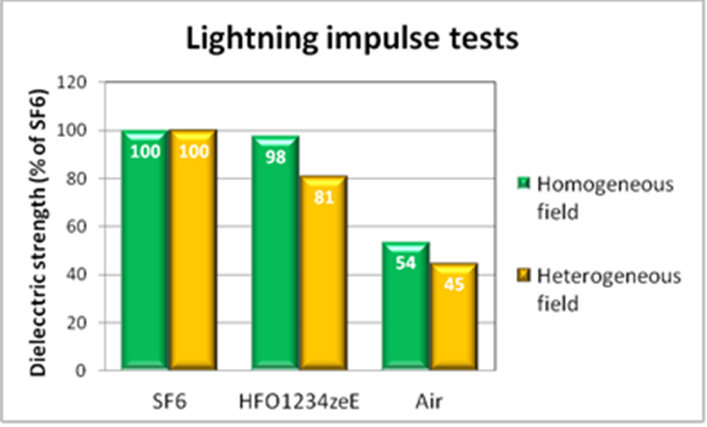
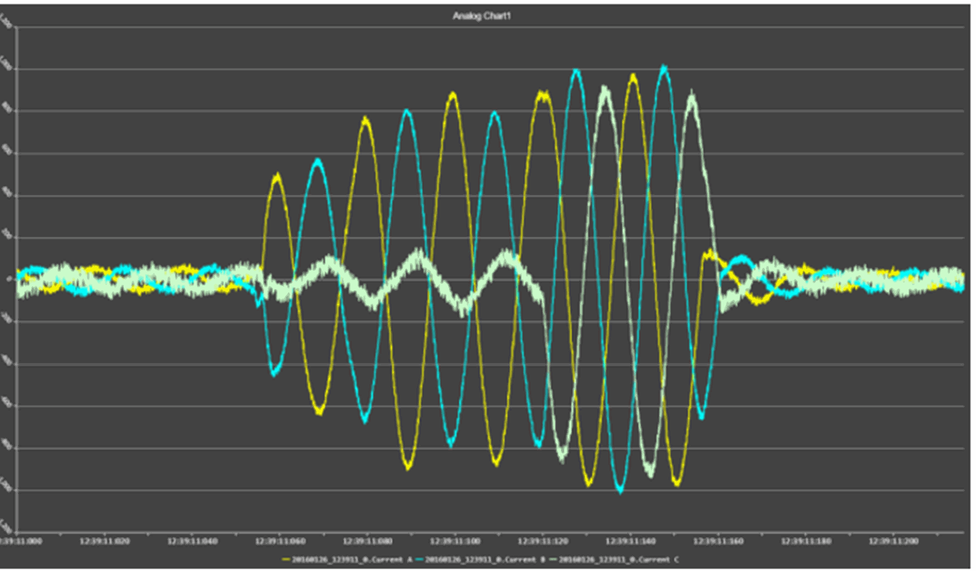
2018 Paris Session
SF6 Alternatives
HFO1234zeE
C₄F₇N/CO₂/O₂
C5 perfluorinated ketone
Vacuum to 145kV heading for 245kV
Alternative gases with GWP <1 are now being commercialised. Vacuum breaker to voltages of 145kV will be for sale in 2019. Organisations need to start thinking about gas handling and certification.
Moderate through faults directly linked to failures
11 high current event in 3 days
Below protection operation levels
Direct input into Condition Index and maintenance
Improvements to maintenance and cost outcomes through better monitoring of network currents.
Picture/graphic for highlight 1
ATC Seminar 2018

Slide 4
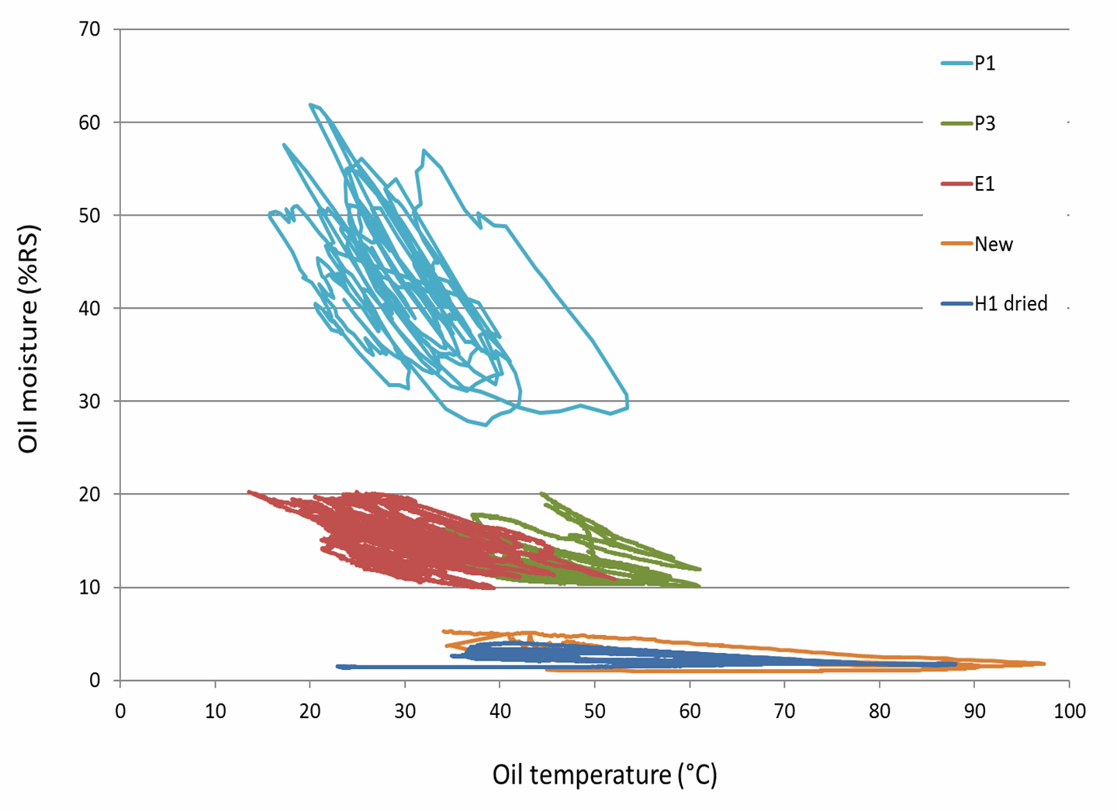
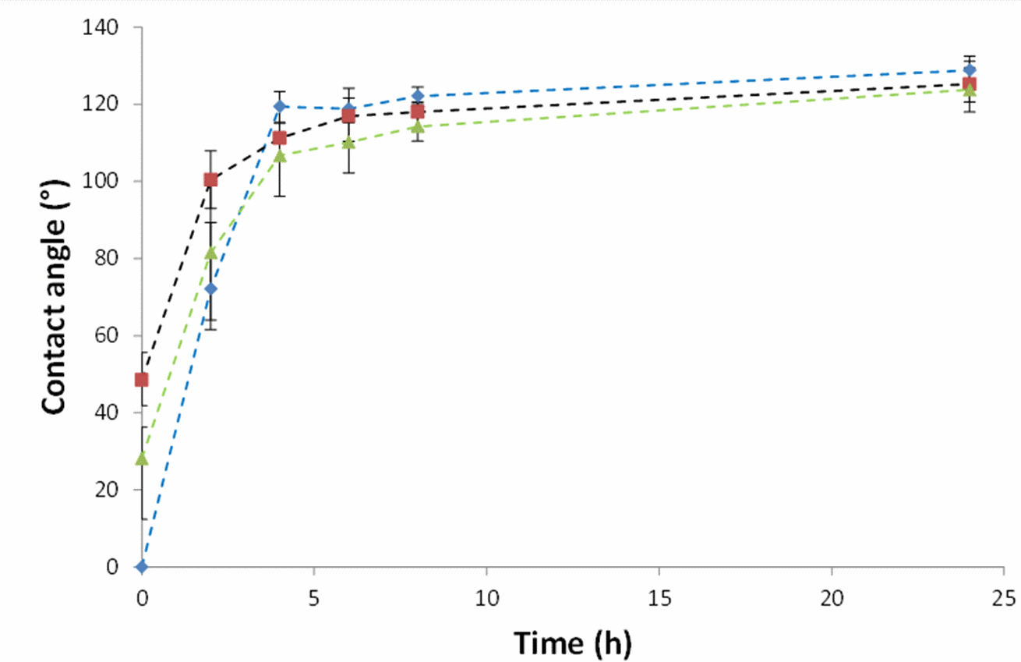
2018 Paris Session
Transformer Oil Moisture Dynamics
New knowledge on monitoring moisture dynamics
Capacitive moisture sensor
Enables better control of paper/oil moisture
Will enable reduced moisture related degradation and risk.
Recovery of Hydrophobicity in Polymeric Insulators
Restored properties after cleaning
Hours
Better understanding and management of polymeric insulation.
Picture/graphic for highlight 2
Picture/graphic for highlight 3
ATC Seminar 2018

Slide 5
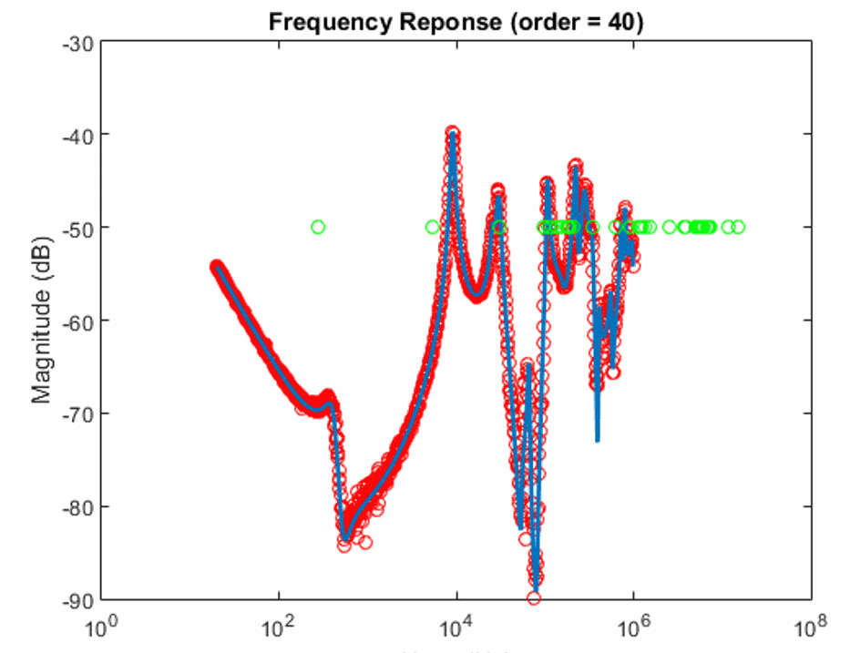
2018 AU/NZ D1 Activities
Highlight
Meeting held 6-7 Nov 2018 in Newcastle
New developments
Wooden pole condition assessment
DC arcing fault detection
Transformer Frequency Response Analysis
VT calibration with gas capacitors
Performance of DC dividers for very fast transients
Participating in WG’s
Convenors for WG D1.60, D1.50, D1.69 and D1.71
D1 is a hub for know-how in measurement, testing and diagnostics. Through a combination of industry, academia
D1.48 | Properties of insulating materials under VLF voltages
D1.59 | Methods for dielectric characterisation of polymeric insulating materials for outdoor applications
D1.60 | Traceable measurement techniques for very fast transients
D1.50 | Atmospheric and altitude correction factors for air gaps and clean insulators
D1.69 | Guidelines for test techniques of High Temperature Superconducting (HTS) systems
D1.71 | Understanding and mitigating corrosion
ATC Seminar 2018

Slide 6
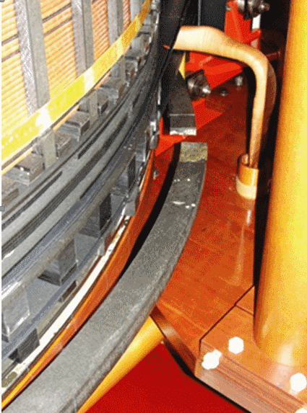
2018 AU/NZ D1 Activities
D1 Papers
D1-310 Parametric Frequency Response Interpretation using Frequency Localising Basis Functions - J. Tusek
D1-320 Steep-front impulse voltage tests on high-voltage equipment – Dr Y. Li
A2-302 The Emerging Role of FRA as a Required Commissioning Test - J. Tusek
C6-312 Learning from a 3.275 MW Utility Scale PV Plant Project: Update and New Remarks – Prof T. Saha.
Carrying out fundamental research in FRA to eliminate most measurement errors.
ATC Seminar 2018

Slide 7
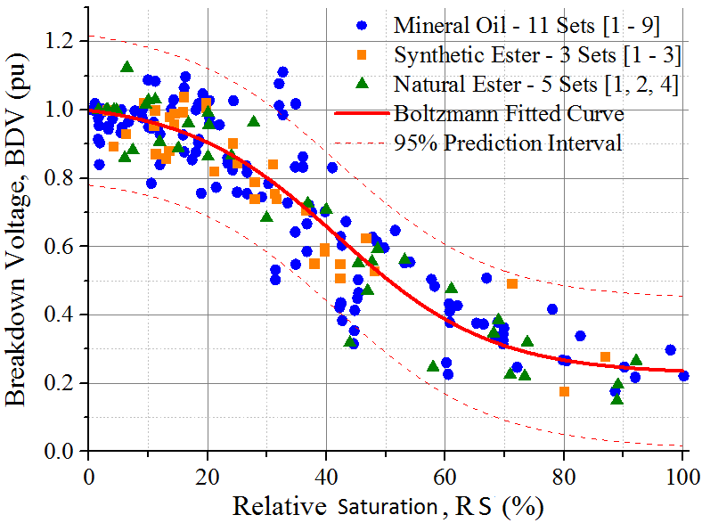
2018 Deliverables
Technical Brochures
TB XXX – Understanding and mitigating corrosion.
TB 741 - Moisture measurement and assessment in transformer insulation - Evaluation of chemical methods and moisture capacitive sensors - 2018
TB 738 - Ageing of liquid impregnated cellulose for power transformers- 2018
TB 730 - Dry air, N2, CO2, and N2/SF6 mixtures for gas-insulated systems - 2018
TB 706 - Guidelines for the use of statistics and statistical tools on life data - 2017
TB 705 - Guidelines for altitude correction of pollution performance of insulators - 2017
TB 703 - Insulation degradation under fast, repetitive voltage pulses - 2017
TB 691 - Pollution test of naturally and artificially contaminated insulators - 2017
TB 676 - Partial discharges in transformers – 2017
ATC Seminar 2018

