Slide 1
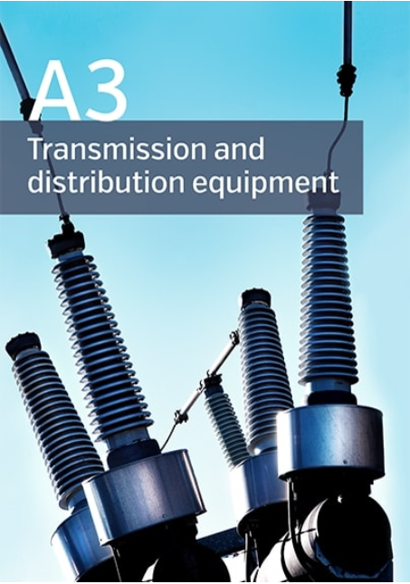
Presented by Wayne Pepper - Convener
Hobart – 15/11/2018

Slide 2
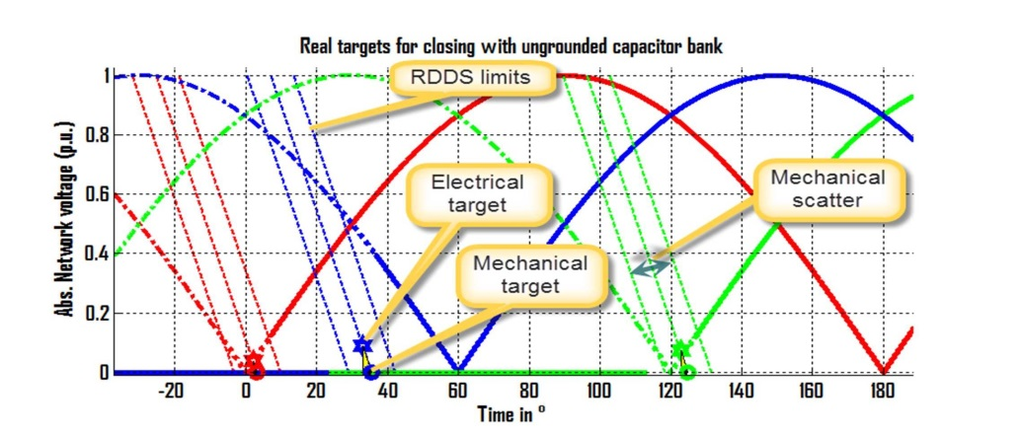
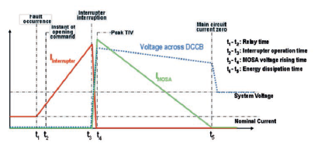
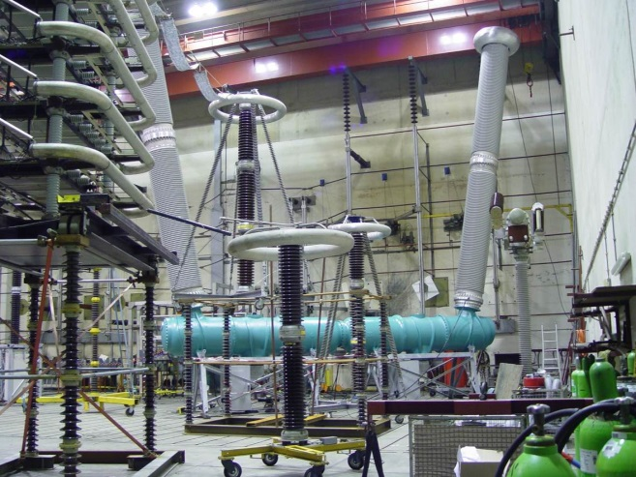
2018 Paris Session
A3 Poster and Technical Session
New format in poster sessions using PowerPoint presentation on display screens. A3 Poster session convenor was AP-A3 representative.
A3 technical session introduced new format, with a lesser number of accepted but quality contributions, combined with experts giving 15 minute technical discussion on the relevant topics, such as Controlled switching, HV equipment type testing, HVDC circuit breaker design, and technical comparison of SF₆ free gases.
A3 Papers relevant to Australia/NZ included topics on:-
Instrument Tx explosive failures
Equipment usage in digital substations
Outdoor insulators
Capacitive current switching
ATC Seminar 2018

Slide 3
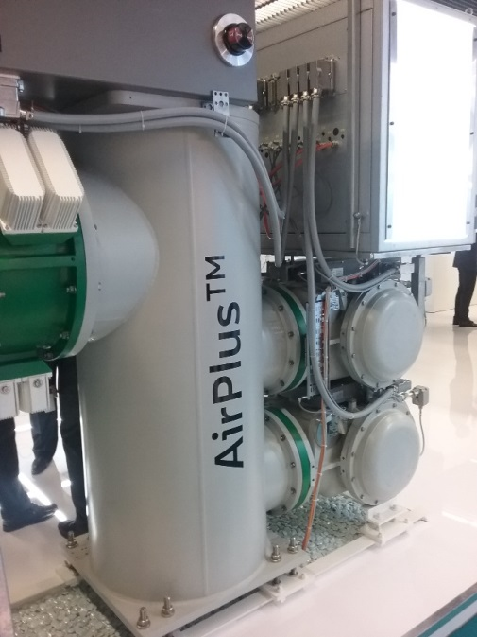
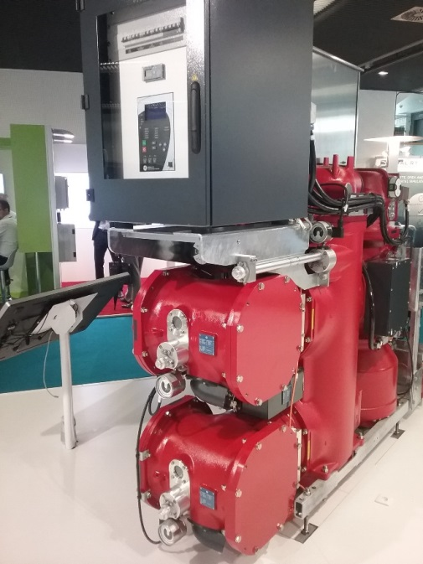
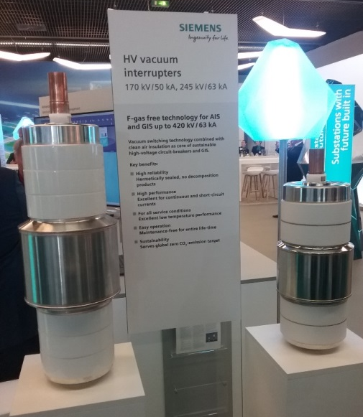
2018 Paris Session
Technical Exhibition
Three major Gas-Insulated-Switchgear equipment suppliers had demonstration units showing the future for high voltage SF6 free switchgear.
Each Paris Session presents the opportunity to show development of SF₆ free HV equipment.
Session papers are written in A3, B3 and D1 SC’s detailing the development works done, further type testing and results of trials being carried out in this area.
WG’s have been established to in several SC’s to look at different facets of the SF₆ free gas mixtures. A3 is looking into switching performance of the different gases.
For Australia, since the carbon tax was repealed in 2014 there has been little emphasis on reducing SF₆ usage, however it is envisaged with mandated legislation in other counties to wind back SF₆ usage, the newer SF₆ free alternatives will be taken up here.
Most users would like a greenhouse friendly alternative to SF₆, a gas that can has the same technical features and similar usability.
ATC Seminar 2018

Slide 4
2018 International Activities
SC A3
A3 had change of name to include Distribution equipment.
New A3 SC Convenor commenced following Paris Session – with technical experience from the Distribution equipment area.
Additional eight A3 SC representatives to cover Distribution equipment area.
Initiated new Equipment reliability survey covering 2014 -2017 period. Retrospective survey using spreadsheet to capture data.
3 WG’s completed their activities, with 3 new WG’s commencing and another 3-4 WG’s to start in 2019. Currently 10 WG’s active.
In September 2019, A3 SC meeting will be in Bucharest, Romania, with Condition Monitoring, Diagnosis and Maintenance (CMDM) conference.
ATC Seminar 2018

Slide 5
2018 AU/NZ Activities
2018 AP-A3 Meeting in Hobart this week hosted by TasNetworks
10 attendees
Discussion points:-
Local and International CIGRE matters since last meeting – 2017 A3 SC and 2018 Paris session, A3 SC matters, WG activities and surveys
Utility and Vendor reports – New equipment, ageing equipment risk assessments, equipment failures presentations, procurement issues, SF₆ management and equipment leak issues
Tour of Creek Road 110/33kV Substation
AP A3 providing information to A3 WG surveys on capacitor switching and reliability survey.
AP-A3 provided Paris Session A3 Technical contribution on Instrument Tx failures
AP A3 member on new WG on IT failure analysis
Photo from AP A3 substation tour to be inserted following meeting on Wednesday
ATC Seminar 2018

Slide 6
2018 Deliverables
Technical Brochures
TB 737 – Non-intrusive methods for condition assessment of distribution and transmission switchgear.
TB 725 – Aging high voltage substation equipment and possible mitigation techniques (AU WG convenor).
TB 716 – System condition for and probability of out-of-phase – (A3/B5/C4).
Green Book
A3 Green Book – “Switching Equipment” published in August 2018
AU contribution to chapter on “Lifetime Management of Equipment”
Contributing to a chapter in future C1 Green Book on “Asset Management”
ATC Seminar 2018

