Slide 1
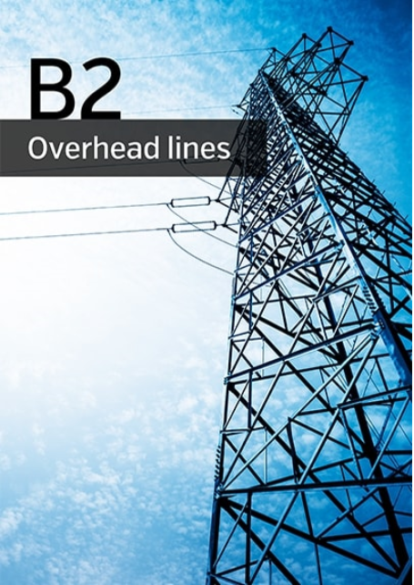
Presented by John McCormack - Convener
Hobart – 15/11/2018

Slide 2
2018 Paris Session: Highlights
B2 Paper & Poster Sessions; WG research and presentations
a) OHL Asset Management: evolution from time-based to condition-based monitoring & replacement strategies for assessment of conductors and hardware components
Relevance to AU/NZ: Asset management practices in Australia are well advanced and some utilities have advanced beyond condition based component assessment and introduced risk based Asset Mgt practices.
b) Sustainability of OHL components:
i) Mitigation of extreme corrosive : Case Study - galvanised coatings stripped from lattice towers after only 5 years of service in coastal regions of Peru.
ii) Residual life of OHL conductor & fittings: Component degradation models; Asset condition monitoring technologies.
Relevance to AU/NZ: Evaluation of residual life and developing cost-effective methods for asset life extension of are paramount for all utilities managing an aging asset base.
ATC Seminar 2018

Slide 3
2018 Paris Session: Highlights
B2 Paper & Poster Sessions; WG research and presentations
c) OHL Security: network-wide structure refurbishment to reduce risk exposure of line failures subject to extreme weather events
Relevance to AU/NZ: I’m from South Australia – do I need to say more!
2. Paris Tutorials
SCC3 EMF - Time to Reassure: update on current understanding of EMF effects on human physiology
Magnetic field varies across the earth; In Paris, the field is about twice the strength as Brazil.
Current research continues to conclude that EMF is highly UNLIKELY to be harmful to humans.
Interesting fact: When next in the Palais des Congress, rotate 360 degrees within 1 second & you will experience an electric field 5x higher than recommended for sustained exposure. You can inform curious bystanders you are conducting a scientific experiment (whilst being removed by security).
Research continues…. the I/N Agency for Research into Cancer still lists EMF as a “possible” cause of cancer.
Relevance to AU/NZ: All AU/NZ utilities adopt a policy of at least “prudent avoidance” regarding EMF exposure to the public. There are cases where utilities have been required to take significant measures to comply with external socio-community planning conditions to reduce EMF fields.
ATC Seminar 2018

Slide 4
2018 Paris Session: Highlights
2. Paris Tutorials (cont)
SCB2 HTLS conductor installation & handling: summary of WG findings/conclusions
HTLS (High temperature low sag) conductor is installed in circuits to improve power line transfer capability; typically used by utilities constrained from establishing new OHL corridors
Operated at 200-250ºC; resultant sag is similar to conventional conductor
Disadvantages: high losses, cost, some HTLS require specialised skills/tools to install.
Relevance to AU/NZ: To date, a small number of circuits in Australia comprise HTLS conductor. Widespread deployment is unlikely until local utilities are faced with the same constraints as their European counterparts.
3. Women In Engineering
300+ attendees including around 25% male CIGRE members
Women represent 8% CIGRE members whom actively contribute to WG’s; 10% of WG convenors; 4 of the 16 SC Chairs; approx. 12% total CIGRE membership.
At the highest level, CIGRE management support & encourage the active contribution of women in the industry.
Presentations focussed on exhorting women to take up the challenge.
Good coffee, croissants and fruit provided for lunch.
Relevance to AU/NZ: Most, if not all, power industry participants actively seeking to engage with and encourage women into the industry in engineering and other technical roles.
ATC Seminar 2018

Slide 5
2018 Paris Session: Highlights
4. SCB2 TAG07 Asset Management and Reliability
AP member appointment as TAG07 Convenor
New Developments of TAG07 Strategy:
- selection of regional representatives to focus on local industry needs
- focus groups/task force appointed to identify potential areas of interest for future WG
- Proposed new topics include:
* Asset Management principles – ask the “why” (WG typically focussed on the "how”)
* Construction technology and safety (incl Helicopter construction)
* Logistics Management for Emergency Restoration of OHL
Safety in Design
(* = TAG07 members appointed at Paris TAG07meeting to lead development of ToR)
Relevance to AU/NZ:
- Opportunity to directly influence B2 strategic direction for the benefit of AU/NZ members
- Nomination of potential AU/NZ convenors to expedite greater level of involvement and return to local industry.
ATC Seminar 2018

Slide 6
2018 AU/NZ Activities – APB2
Strategy:
Engage with broader industry (eg DNSP, Research Establishments, potential members)
Invite targeted persons to interact with APB2 via CiGRE KMS “Specialist” status
Encourage NGN participation
Panel Meeting – Hobart, November 2018
WG progress reports
ToR review – UAV’s, MV/LV conductor, Risk Management, Foundations, Lightning performance, OHL assets & fire
Case Studies:
Novel structure designs for European OHL
Safe Management of Helicopter Line Construction
Conductor noise testing
Conductor Degradation & Serviceability assessment
Dynamic Line Rating
NGN presentations
Mitigation Strategies for Bird Strikes on OHL
WG 55 Tutorial: Conductors for the Uprating Overhead Lines
29 Attendees including 6 invited guests, and 3 NGN reps, ANC representative (Terry Killen)
Next Panel Meeting & Technical Seminar – Sydney, 2019
Seminar Theme: Asset Performance of OHL Assets (tbc)
ATC Seminar 2018

Slide 7
2018 Deliverables: Publications
WG | Title | Status | Ref.
B2.23 | Geotechnical and structural design of foundations for HV & UHV Lines | Final draft due 2018
B2.24 | Qualification of HV and UHV Overhead Line Supports under static and dynamic Loads | Final draft due 2018
B2.40 | Calculations of the electrical distances between live parts and obstacles for OHL | Final draft Early 2019
B2.45 | Vegetation fire characteristics and potential impacts on OHL performance | Publication pending (2019)
B2.47 | Guide for repair of conductors & conductor fitting systems | Published 2017 | TB 708
B2.48 | Experience with non-conventional conductor | Published 2017 | TB 695
Technical Brochures
Picture/graphic for highlight 1
ATC Seminar 2018

Slide 8
2018 Deliverables: Publications
WG | Title | Status | Ref.
B2.50 | Safe handling of fittings and conductors | Final review Due 2018
B2.51 | Methods for optimized design of overhead transmission lines | Published 2016 | TB 638
B2.52 | The use of robotic in assessment and maintenance of OH | Published 2018 | TB 731
B2.53 | Management guidelines for outsourcing OHTL technical expertise | Publication pending (2019) | TB 744
B2.55 | Conductors for the Uprating of Existing Overhead Line | Final Draft Due 2018
B2.56 | Ground Potential Rise at Overhead AC Transmission Line Structures during Faults | Published 2018 | TB 694
Technical Brochures
Picture/graphic for highlight 1
ATC Seminar 2018

Slide 9
2018 Deliverables: Publications
WG | Title | Status | Ref.
JWG C3/ B1/B2.13 | Environmental Issues for Transmission Lines in Rural & Urban Areas | Final review Due 2018
 | Calculation accuracy of high-temperature sag for ACSR in existing lines | Published June 2017 | CSE 7
 | Efficient Computation and Experimental Validation of ACSR OHL Conductors under Tension and Bending | Published October 2017 | CSE 9
Picture/graphic for highlight 1
ATC Seminar 2018

