Slide 1
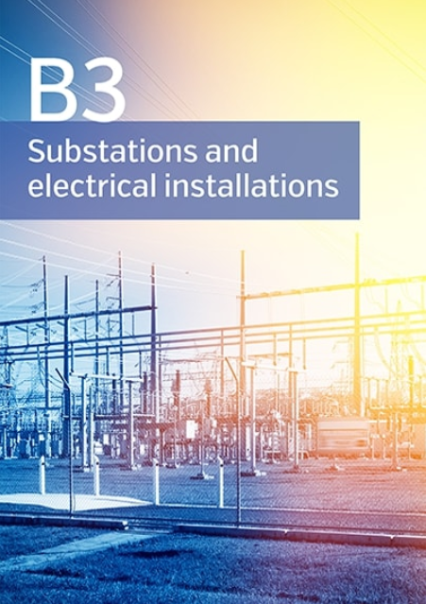
Presented by Crina Costan - Convener
Hobart – 15/11/2018

Slide 2
SC B3 Overview
Our Mission
SC B3 aims to facilitate and promote the progress of engineering and exchange of information and knowledge in the field of substations and electrical installations. SC B3 acts to add value to this information and knowledge by means of synthesizing state-of-the-art practices, developing recommendations and providing best practice.
Scope SC B3
The activities cover the design, construction, maintenance and ongoing management of substations and the electrical installation in power stations excluding generators.
SC B3 serves a wide range of target groups in the Electric Power Industry whose needs include the technical, economic, environmental and social aspects in varying degrees.
Major objectives include increased reliability and availability, cost effective engineering solutions, managed environmental impact, effective asset management and the adoption of appropriate technological advances in equipment and systems to achieve these objectives.
ATC Seminar 2018

Slide 3
2018 Paris Session
7 Working Group (WG) Meetings:
SF₆ Green Book on Sat - Sun Aug 25-26
B3 Annual Study Committee Meeting, 40 countries represented.
B3 Poster Session, 35 posters displayed : 484 visitors
B3 Tutorial “Low-Cost Substations in Developing Countries” :206 registered attendees
B3 Discussion Meeting: 568 attendees, 56 prepared, plus 89 spontaneous contributions
The AP.B3 had 7 contributions
B3 Workshop “Safe Working in Substations” : 70 attendees
ATC Seminar 2018

Slide 4
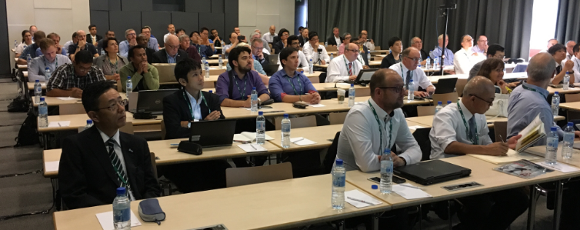
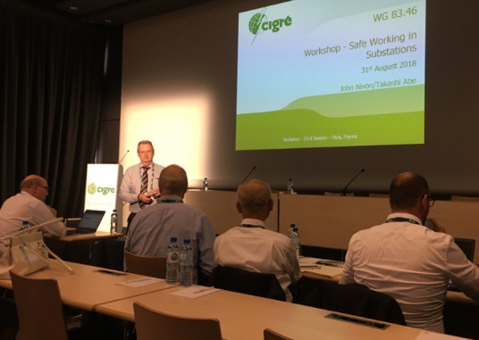
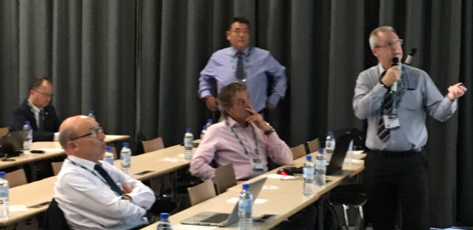
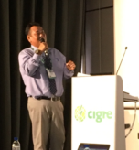
Paris B3.46 Workshop – August 31
“Safe Working in Substations”
70 attendees
combined into 8 working teams
ATC Seminar 2018

Slide 5
B3 Working Group Meetings in Paris
WG.B3.34: Expected impact of future grid concept
WG.B3.38: Management of risk in substations
WG. B3.43: Contemporary solutions for low cost substations
WG.B3.45: Application of non-SF₆ gases or gas-mixtures in MV and HV GIS
WG.B3.46: Guidelines for Safe Work Methods in Substations
WG.B3.49: Review of substation busbar component reliability
WG.B3.53 (new): Guidelines for fire risk assessment and mitigation in substations
SF₆ Green Book
ATC Seminar 2018

Slide 6
B3 Current and Future Meetings and Events
AP. B3 Substation Conference – Hunter Valley Nov-Dec 2019
Chairing IEEE Power and Energy Society in Victoria
Contribution to IEEE standards
Future B3 meetings:
2019 Symposium in Chengdu, China - with C6; and also B5, C1, C3, and D2
2021 Symposium in Bucharest, Romania – with A2
2023 – New Delhi, India or Cairns, Australia?
Other Future events:
IEC Conference on UHV AC/DC Trends – Hakodate, Japan April 23-26, 2019
Conference on Condition Monitoring – Bucharest, Romania Sept 7-13, 2019
ATC Seminar 2018

Slide 7
B3 Deliverables
B3 has 26 active WG’s, 3 recent Technical Brochures, with the Substation Green Book now published and available for sale or download:
TB 723 “SF₆ Measurement Guide” WG 40
TB 734 “Management of Risk in Substations ” WG 38
TB 740 “Contemporary Design of Low Cost Substations in Developing Countries” WG 43
ATC Seminar 2018

Slide 8
AP.B3 New WG Members
WG B3.52 Neutral Grounding Method Selection and Fault Handling for Substations in the Distribution Grid
Bill Carman as Correspondent Member
WG.B3.53 (new): Guidelines for fire risk assessment and mitigation in substations
Michael Verrier, Terry Lee as Members and Derek Perkins as Correspondent Member
Created a Mirror Panel for WG.B3.53 in AP comprising: Robert Li, Dan Tang, Michael Verrier, Kerry Williams
WG.B3.54 Earthing System Testing Methods
Stephen Palmer WG Convener
WG B3.55 Design guidelines for substations connecting battery energy storage solutions (BESS)
Crina Costan: as Correspondent Member
WG B3.56 Application of 3D Technologies in Substation Engineering Works
Todd Margitich: Member
WG.B3.46: Guidelines for Safe Work Methods in Substations
Perry Tonking as Correspondent Member
ATC Seminar 2018

Slide 9
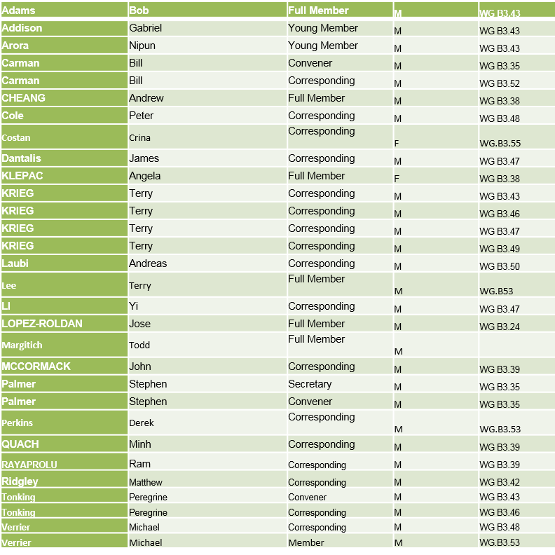
Australian Contributions to WG.B3
ATC Seminar 2018

