Slide 1
CIGRE Australia Annual General Meeting 15 November 2024

Slide 2
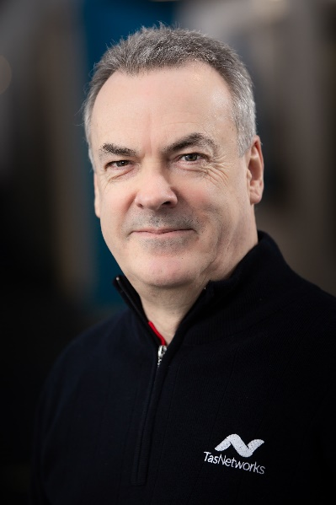
Chairman’s Report 2024 AGM
Sean McGoldrick
CIGRE Australia Chairman
November 2024

Slide 3
Outline
Performance, Governance and Management
2024-2027 Strategic Plan
Quality Events Valued by Industry
People
This presentation will provide an overview of some of the key components of CIGRE Australia’s operations over the past 12 months - further detail on a number of these matters will be provided by later presenters.

Slide 4
Performance, Governance and Management
2024 was a very good year by all measures – we are well placed to build upon our growth, financial stability and reputation
Strong financial position due to prudent financial management over a number of years and a successful Cairns Symposium
Excellent total membership growth in FY24 - +18.5% compared to end of FY23.
The delivery of three major events over the past 12 months or so - the Cairns Symposium (September 2023), the Transformer and Reactor Workshop (April 2024) and the Power Electronics and Power System Integration Seminar (October 2024) - and regular NGN webinars.
Review of financial policies completed (Financial Delegations and Investment Policy). Remaining policies will be updated over the balance of this financial year.
Our approach to investments updated to be a little less conservative to achieve better returns over the longer term

Slide 5
Quality Events Valued by Industry
Cairns Symposium
The largest CIGRE event ever held by outside Paris with 1377 delegates
93.6% of delegates rated the Symposium Very Good to Excellent
Transformer and Reactor Workshop
107 delegates
80.0% of delegates rated the Workshop Very Good to Excellent (and a further 17.1% Good or better)
Power Electronics and Power System Integration Seminar – a joint B4/B5/C2/C4 Seminar
139 delegates
93.0% of delegates rated the Seminar Very Good to Excellent
Each event was also run at a surplus, providing some diversification of revenue from member and Panel fees

Slide 6
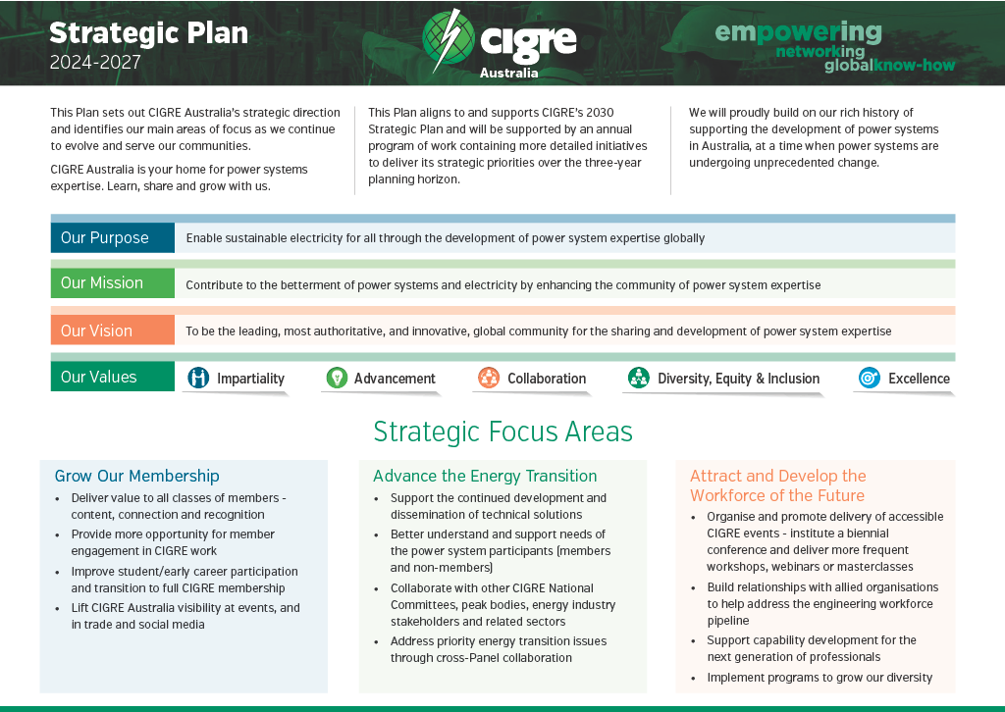
2024-2027 Strategic Plan
Our new three-year Strategic Plan was released in July 2024, aligning to the first three years of the CIGRE 2030 Plan
Three strategic focus areas:
Grow our membership
Advance the energy transition
Attract and develop the workforce of the future
The Strategic Plan is supported by a Business Plan which will be updated prior to the start of each financial year, and which provides details on specific initiatives in the following 12 months.
Our Values were also updated in a consultative process - with work to follow over the next 12 months to better define their application through aligned behaviours

Slide 7
People
A collegiate and committed Board - that met eight times last financial year. The Finance, Risk and Audit Committee met on five occasions. A special acknowledgement for departing Board members Alison Andrew and Stewart Bell.
A seamless transition of Chief Executive Officer from Terry Killen to Peter McIntyre
A healthy attendance by members at the Paris Session in 2024 - over 100 ANC members attending the Session.
We remain dependent on the expertise and goodwill of our members who graciously give their time and knowledge to support us – we are indebted to you for your support. Particular acknowledgement is provided for our Study Committee and Australian Panel Convenors for the significant roles they undertake.

Slide 8
Treasurer’s Report
Tara-lee MacArthur
Treasurer
November 2024

Slide 9
CIGRE Australia Financial Trend

Slide 10
Cairns Symposium Summary
$810k profit on the Cairns Symposium
Overall profit retained by CIGRE Australia $453k
Agreement up front with CIGRE Paris with a 50:50 risk sharing/profit sharing (each party exposed to half the upside and downside)
The Paris payment was less than 50% of the net profit as the Symposium included SEAPAC and CIDER (regular conferences for CIGRE Australia) for which an allowance for foregone revenue was agreed with Paris
Includes some salary and wages expenses from prior years (accounting rules allow revenues and external expenses to be accrued, salaries and wages paid must be expensed in the year they happened)

Slide 11
Investment Performance and Strategy

Slide 12
Changes to Investment Strategy
Investment policy traditionally conservative with term deposits and a bond portfolio (FIIG) - typically generating returns around or marginally in excess of CPI.
Board approved new Investment Policy in July 2024 allowing managed investments with exposure to other asset classes such as equities and property trusts, so long as the overall investment portfolio was ‘conservative’ or ‘balanced’ in its risk and return profile.
The Board selected Perpetual as the provider of a new managed investment fund. It is a growth fund, with an investment horizon of 10 years and a target annual average return of 3.5% above CPI.
The Perpetual fund was established in August 2024 with $200k from a maturing term deposit and $300k liquidated from the FIIG portfolio ($500k total).
The Perpetual fund comprises approximately 40% index of international equities (with an ESG profile), 30% index of Australian equities and the balance other asset classes including property funds and alternative assets.

Slide 13
Implementation of Investment Strategy
Investment Snapshot - 31 October 2024
Investments | Amount | Percentage Allocation | Risk Characteristic
Term Deposits | $806k | 35.9% | Conservative
FIIG Bond Portfolio | $931k | 41.5% | Conservative
Perpetual Managed Fund | $507k | 22.6% | Growth
Total Investments | $2244k | 100.0% | Conservative - Balanced
Notes:
Excludes cash on call held in cheque and online saver accounts ($120k)
Amount held in term deposits will vary with annual cash flow cycle

Slide 14
Budget and Forecast
Notes:
So what are we forecasting for the current and next couple of years?

Slide 15
2025 BUDGET AND FORECAST
Supporting Australian Panel and Working Group Convenors
Paris was an expensive year with increased costs due to event being held around the Olympics and Paralympics
Study Committee meetings to be held in the first half of 2025
Running more events
Power Electronics and Power System Integration Seminar
Transformer and Reactor Workshop
Annual Member Dinner
CIGRE Australia Conferences 2025 – Adelaide
New website
Supporting NGN and WIE initiatives

Slide 16
2025 BUDGET AND FORECAST
Year | Actual 2023 | Actual 2024 | Budget 2025 | Forecast 2026 | Forecast 2027
Total Revenue | $772,243 | $ 3,614,533 | $1,006,425 | $2,013,574 | $1,136,220
Total Expenses | $943,006 | $3,158,554 | $1,115,696 | $1,868,576 | $1,167,656
Operating Surplus | -$170,763 | $ 455,979 | -$ 109,271 | $ 144,998 | -$ 31,436
Equity as at 30 June | $1,843,689 | $ 2,299,668 | $ 2,190,397 | $2,335,395 | $2,303,959

Slide 17
2025 Membership Fees
Membership and Panel Fees - 2025
Fee Category | Current Fee | Panel Fees - 2025 | Change from 2024
Individual 1 | $360 | $369 | 2.5%
Individual 2 | $180 | $184 | 2.5%
Collective 1B | $2141 | $2194 | 2.5%
Collective 1A | $2678 | $2745 | 2.5%
Collective IA T&D | $8878 | $9100 | 2.5%
Collective 2 | $1071 | $1098 | 2.5%
Panel | $988 | $1012 | 2.5%
Notes:
Fee increase capped to 2.5% (below CPI)
Includes Paris component

Slide 18
Conclusion
The Board recognises the need to be financially responsible.
We will aim to operate to the indicated budget and forecast and keep within acceptable surplus/deficit results.
Administrative operational costs continue to be monitored and reduced where possible.
This year the board developed a new investment strategy and will be closely monitored delivering an investment strategy with more diversity and an appropriate risk profile.
Invoices for membership will be issued late November to early December 2024, with payment due by the end of the 2024 calendar year.

Slide 19
THANK YOU

Slide 20
Chief Executive Officer’s Report 2024 AGM
Peter McIntyre
November 2024

Slide 21
Outline
CIGRE’s latest strategic plan and some current year initiatives
ANC in the world of CIGRE National Committees
Membership update
Where next….

Slide 22
Our Strategic Plan 2024-2027

Slide 23
Some of our Business Plan Initiatives for FY2025
Refine our new customer segmented marketing plan, our stakeholder plans and review our communications and channels
Launch new website
Events: B4/B5/C2/C4 Power Electronics and Power System Integration Workshop, ATC Presentation Day, CEO/Senior Executive Roundtable, 2025 Conference in Adelaide including SEAPAC, CIDER
Women in Energy engagement plan
Refine our strategy to grow NGN numbers and capabilities, including looking at a trial with a Panel of an NGN-supported WG addressing a practical problem for the energy transition in Australia
Establish partner organisations for building a case for workforce pipeline advocacy to Commonwealth and establish governance and strategy

Slide 24
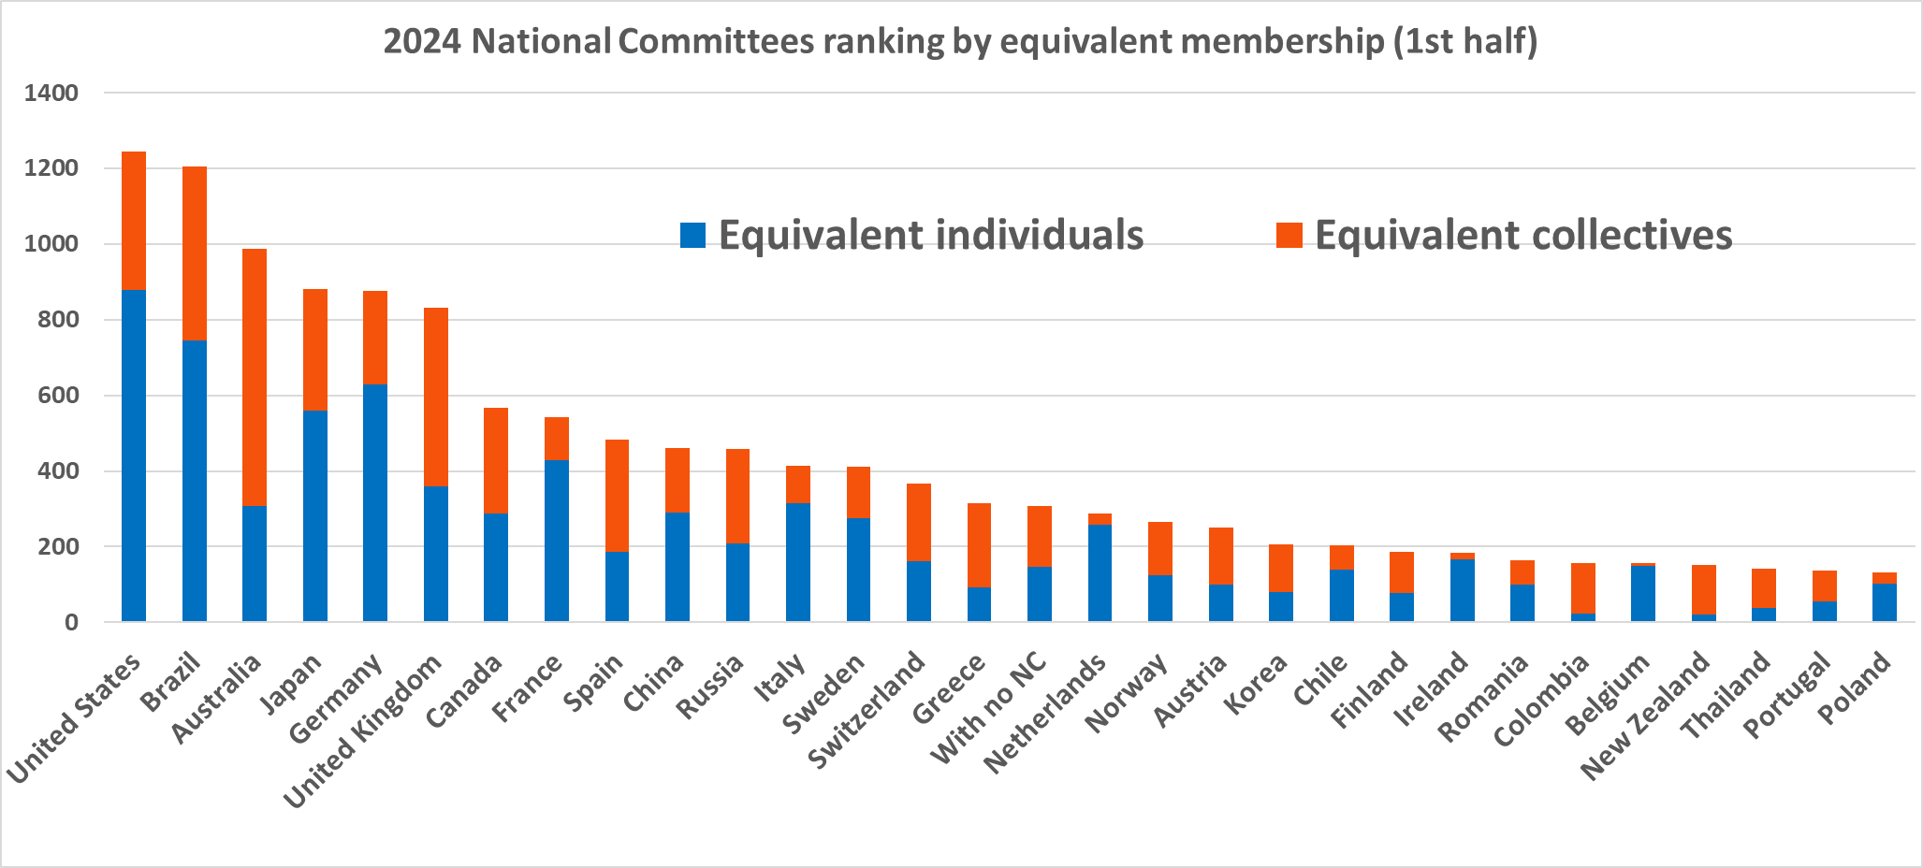
National Committee Membership Ranking – June 2024
Number 3
Automatic seat on CIGRE Steering Committee through to 2026. Opportunity to influence CIGRE direction.

Slide 25
ANC Current Growth Rate is Strong
As at 15 November:
335 Individual 1/Hon/Fellow
46 Individual 2
116 Collective 1
12 Collective2
6 International Collective
53 Students
At 15 November, an Equivalent Membership of 1190: +8.6% so far this financial year after a 14% growth in FY24.
https://www.cigre.org/GB/about/official-documents
Notes:
Storage is obvious and may require a new structural element but gases and fuels may be outside >> to be determined

Slide 26
Where next…
CIGRE has introduced news rules to help reduce attrition (from 2025):
students obtain the first year in employment free of charge to help transition into the workforce
Individual 2 rates now apply for three years rather than two (subject to age limit of 35)
The Board will be considering our international strategy in early December – ideas are welcome.
Our premier event in 2025 will be a suite of conferences in Adelaide 2-4 September including the 9th SEAPAC and the 6th CIDER along with plenary sessions, general streams, Women in Energy and NGN content and/or events.

Slide 27
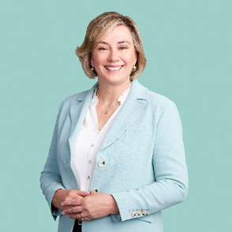
Annual General Meeting 2024 Australian Technical Committee (ATC) Presentation
Angela Klepac – ATC Chair Person
Angela.Klepac@gmail.com
15th November 2024

Slide 28
Agenda for today
2024 Year in Review
Transformer Workshop
CIGRE Paris 2024 Session
Power Electronics and Power System Integration Seminar
2024 Australian Technical Committee Presentation Day

Slide 29
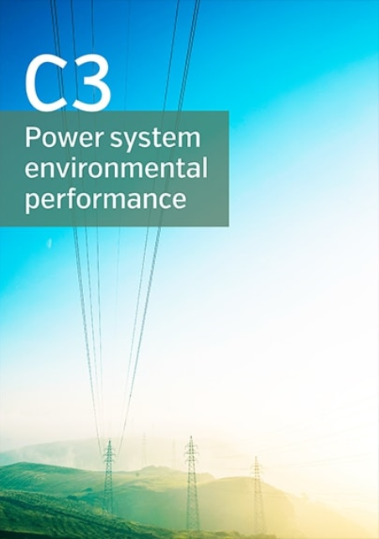
1. 2024 Year In review
Another successful year
Acknowledgement of the important work our convenors undertake in keeping the Australian panels highly engaged and at the same time collaborating with their local and international counterparts via AP, SC, WG meetings, workshops, tutorials and facilitating technical discussion sessions
High engagement and involvement of NGN members on all Panels
Focus on delivering seminars/workshops on key industry issues
Local events held this year :
Transformer Workshop – 31st April to 2nd May
Power Electronics and Power System Integration Seminar 29th to 30th October
ATC Presentation Day 14th November 2024
Australian panel meetings held in the year
Attendance at the Paris 2024 Session

Slide 30
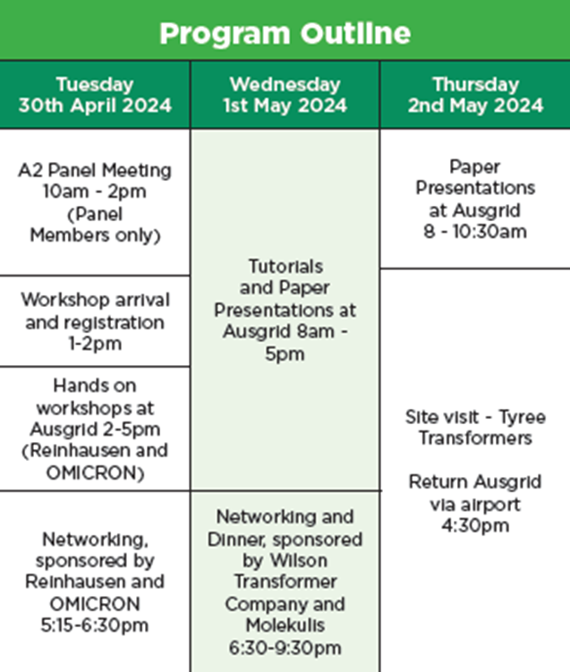
2. Transformer Workshop
3-day event held in Sydney on 31st April to 2nd May 2024
~110 delegates, 15 speakers
Host :
AusGrid
Sponsors :
OMICRON, Reinhausen Australia, Wilson Transformers and Molkulis
Technical Tour :
Tyree Transformers
Thank you to Organising Committee :
Matthew Gibson – AU A2 Convenor
Tara-Lee Macarthur - CIGRE Australia - Director on board and panel member on A2 Transformers
Others

Slide 31
Key Themes
Dissolved Gas Analysis
Mechanisms of fault gas production in Transformers
Application of DGA to different styles of tap changer
Case study - H2 sensor application
Varied gas signatures of esters – published limits inadequate
Corrosive Sulphur
Emerging issue with silver sulphide formation in tap changers
Mechanisms of formation
Suggestions for condition assessment, testing and mitigation solutions
New materials & thermal performance
New work in IEC standards
New temp limits for thermally upgraded paper
Practical examples of increased TX loading using esters & upgraded paper
Efficiency & sustainability
Technical aspects considered for proposed changes to min energy performance levels for distribution TXs.
Environmental vs CO2 footprint, life cycle assessment, impact categories.

Slide 32
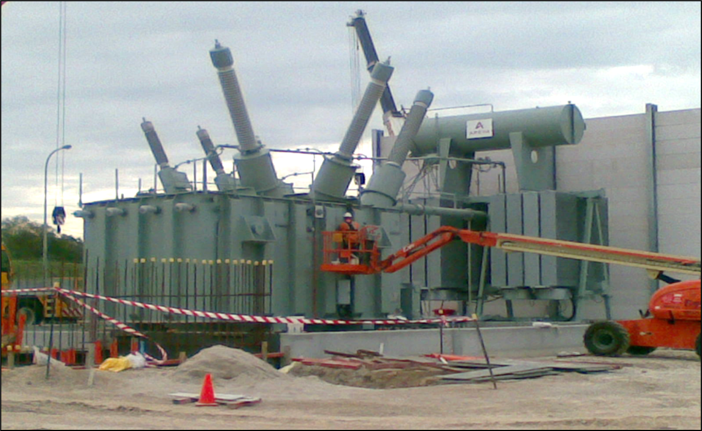
TUTORIALS
WG A2.58 Site Installation & Pre-commissioning of Transformers & Shunt Reactors
Discussion of fundamental steps and processes involved with site installation & testing => ready for commissioning
Delivery & positioning, stages of assembly, oil handling & vacuum filling, FAT vs SAT, recommended site tests & actions during trial operation
Technical Brochure early next year 2025
WG A2.62 The use of TX reliability statistics to make quantitative assessments of operation risk
How can failure modes and probability of failure be used to make the best-informed decisions?
Aust / NZ data vs global trends
Technical Brochure is now out – e-cigre

Slide 33
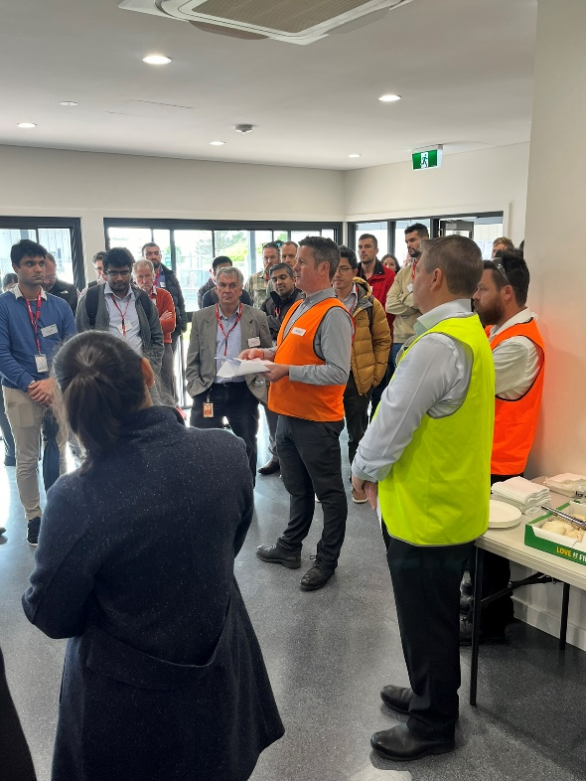
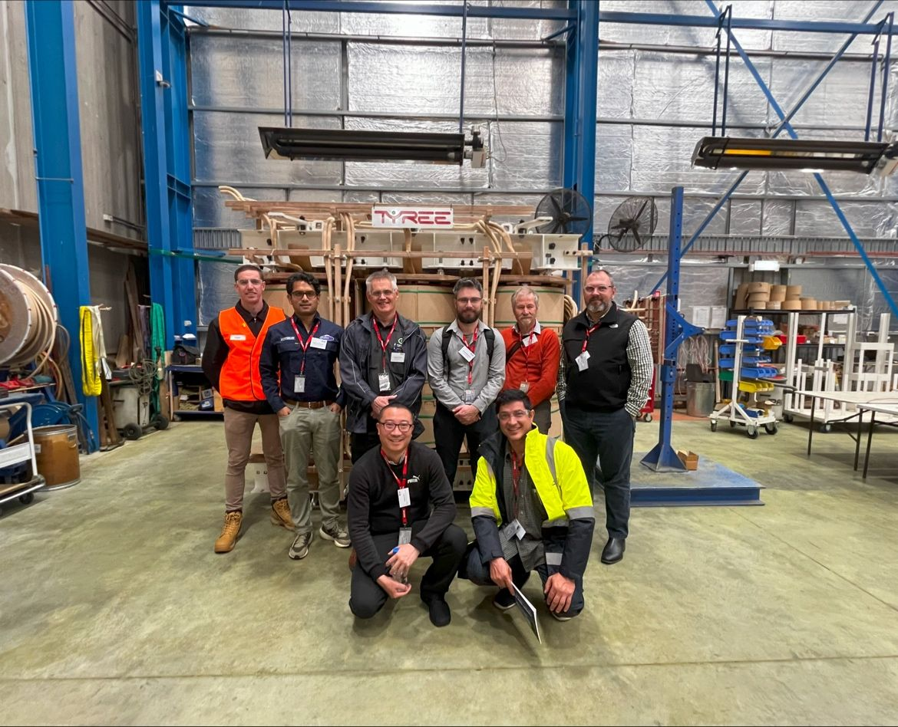
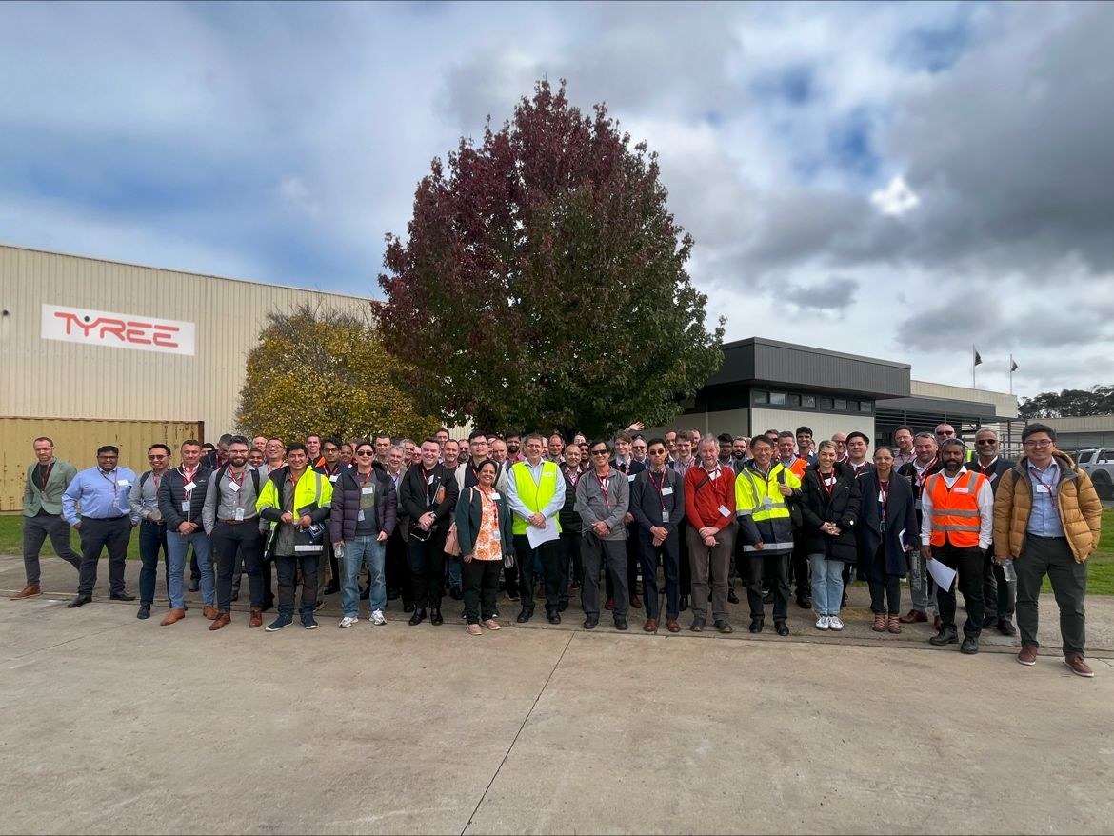
Technical tour – Tyree transformer factory
Short company history
Power & distribution transformer factory tour

Slide 34
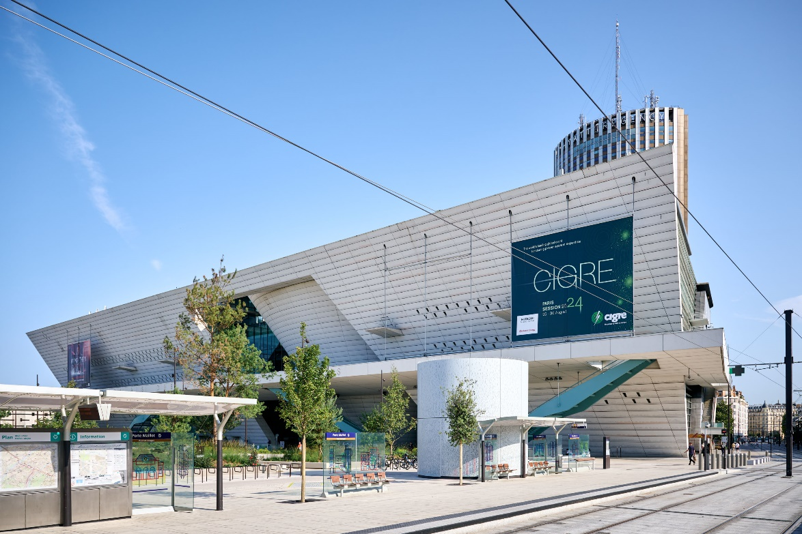
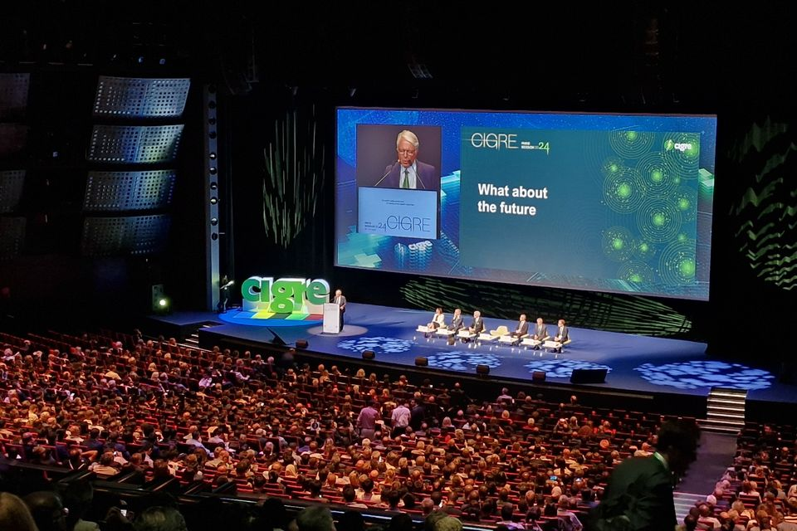
3. CIGRE Paris 2024 Session
Biennial Session held
25th to 30th August 2024
Palais des Congres, Paris, France

Slide 35
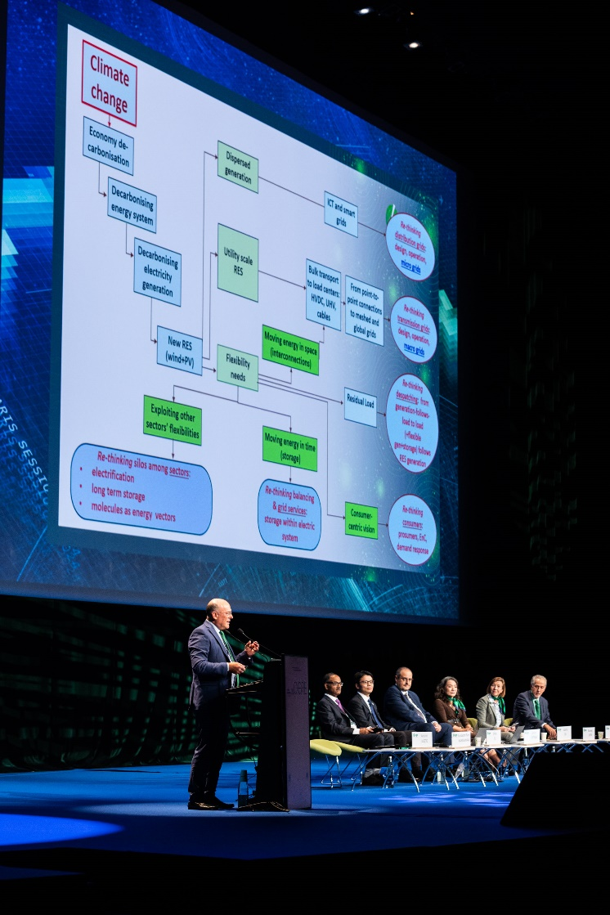
Paris 2024 – About the Session – Attendance and participation records broken
Key theme for 2024 - “End to End Power System”
Event is held on a two-yearly cycle
Throughout the event, CIGRE’s focus is to operate the world’s foremost collaborative knowledge development and sharing programs
Face to Face event held in Paris , France at the ‘Palais des Congres’
Attracted over 11,000 power and energy participants globally from over 100 countries, including over 4500 delegates/international experts and other decision makers
Over 160 working group meetings
Over 30 Study Committee sessions
Over 1100 technical papers presented across a range of disciplines (~800 in 2022)
Over 300 technical exhibitions providing international companies to share and exhibit the latest in innovation, products and services

Slide 36
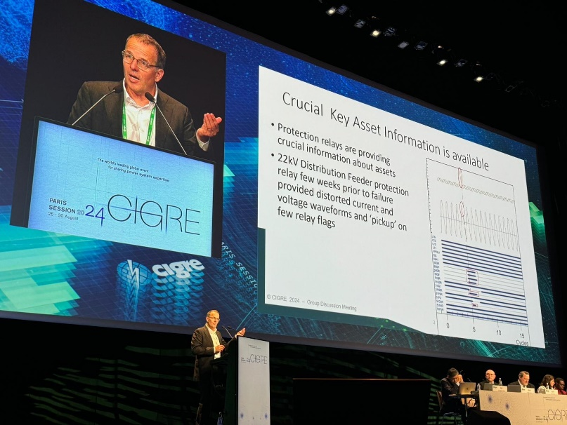
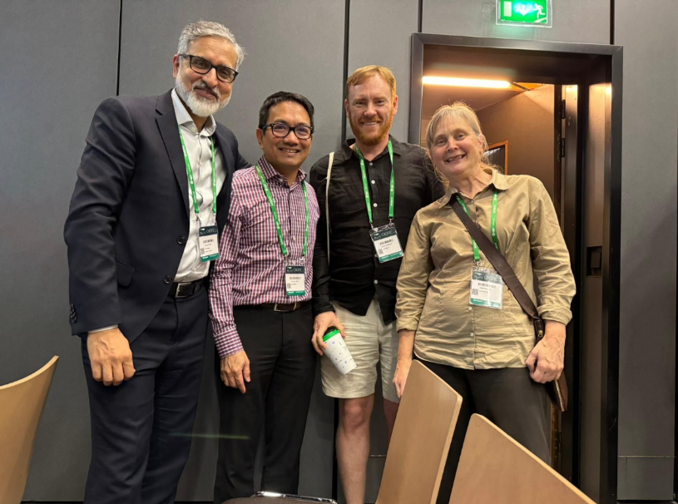
Paris 2024 – About the Session – Australian participation
14 of the 16 Australian convenors in attendance
x2 Study Committee Chairmen in attendance - Alex Cruikshank and Victor Tan
Overall Australian registrations >100
x19 Australian papers were accepted and presented
> 40 individual contributions across the 16 panel areas at the group meetings in response to special reporter questions

Slide 37
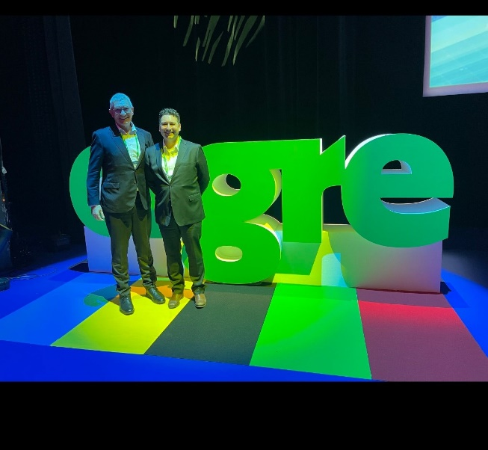
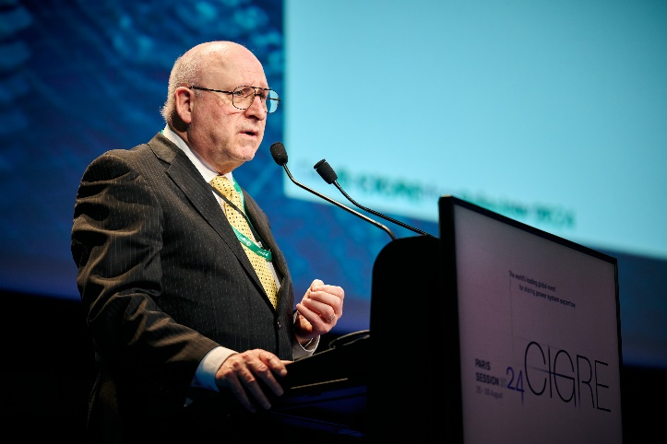
Paris 2024 – About the Session – Australian participation
A tutorial (two hours) delivered by B2 - Transmission Lines Convenor Asif Bhangor
WG B2.77 – Risk Management of Overhead Line Networks “A model for identification, evaluation and mitigation of operational risks”
Large disturbance workshop
Opening and first session chaired by Alex Cruikshank
Second session presentation from Australia on “Impacts of High Penetration of Distributed Energy Resources in South Australia by Brad Harrison, ElectraNet and Rainer Korte, CIGRE Australia”
WiE and NGN Involvement

Slide 38
4. Power System Harmonics and Power System Integration Seminar

Slide 39
Power System Harmonics and Power System Integration Seminar
DATE : Tuesday 29th & Wednesday 30th October 2024
LOCATION : Pullman Sydney Hyde Park, 36 College Street, Sydney
THEME :
Exploring the issues and challenges associated with the high penetration of power electronic interfaced devices on the power system.
This seminar was an industry discussion on existing and emerging challenges associated with the technical aspects of power system performance, modelling, analysis, protection and control, and operation in a changing power system environment and with the evolution of power electronic devices.
KEYNOTE SPEAKERS :
Mr Bernard Norton - Country MD - Hitachi Energy Australia
Ms Merryn York – EGM System Design AEMO
Mr Damien Sanford - COO Tilt Renewables

Slide 40
Registrations and Presentations
Over 130 registered for the seminar event
38 presentations across six sessions
36 from East Coast Australia
1 from Western Australia
1 from New Zealand
No paper submissions required just presentations and opportunity for discussion
Presenters from a wide range of industry representatives:
AEMO
CSIRO
TNSPs and DNSPs
Developers
Consultants
OEMs
Academia/Universities (x5 presentations – UNSW, Monash University and University of QLD)

Slide 41
Organising Committee and Participating panels – Thank you
John Wright-Smith – B4 DC Systems and Power Electronics
Rob Coggan – B5 Protection and Automation
Tjaart Van Der Walt – C2 Power System Operation and Control
Babak Badrzadeh – C4 Power System Technical Performance
Peter McIntyre – CEO CIGRE Australia
Angela Klepac - CIGRE Australia ATC Chairperson

Slide 42
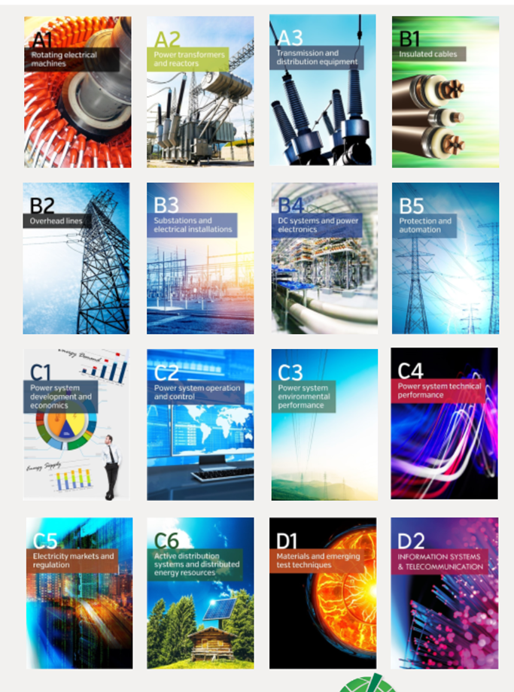
5. 2024 – ATC Annual Technical Presentation Day
Successful ATC Annual Technical Presentation Day held 14th November 2024
Event Location – Hosted by Energy Queensland
Purpose of the Day
Promote the technical work of CIGRE and inform our members of technical highlights achieved across 2024
Provide key insights from SC and Panel activities
Presentation from each panel convenor focussing on those activities with highest relevance to CIGRE Australia members
Panel presentations will form part of the annual report provided to members
Each of our Technical Panel Convenors and were available in person to take questions
Presentations from our Study Committee Chairs - Victor Tan and Alex Cruickshank
Session was recorded and will be posted to CIGRE Australia You Tube site shortly

Slide 43
2024 – ATC Annual Technical Reports
Annual report will be available electronically by the end of 2024:
ATC report summarising key technical activities and achievements across 2024
Reports from all 16 Australian Panels
Reports from each WG member/convenor who received financial support during 2024
Event Reports
Technical Information is also available to CIGRE members electronically through e-cigre (https://e-cigre.org/ )

Slide 44
Contact details for our AP Convenors
 | Panel | Scope | Convenor | Email
Equipment | A1 | Rotating electrical machines | Len Gunn | Len.gunn@originenergy.com.au
 | A2 | Power transformers and reactors | Matthew Gibson | matthewg@ausgrid.com.au
 | A3 | Transmission and distribution equipment | David Pita | dpita@powerlink.com.au
Technologies | B1 | Insulated cables | Rob Bradley | rbradley@ausgrid.com.au
 | B2 | Overhead lines | Asif Bhangor | bhangorian@gmail.com
 | B3 | Substations and electrical installations | Andreas Laubi | andreas.Laubi@aurecongroup.com
 | B4 | DC systems and power electronics | John Wright-Smith | john.t.wright-smith@bigpond.com
 | B5 | Protection and automation | Rob Coggan | rob.coggan@energyq.com.au
Systems | C1 | Power system development and economics | Christian Schaefer | christian.schaefer@ghd.com
 | C2 | Power system operations and control | Tjaart Van Der Walt | tjaart.vanderwalt@aemo.com.au
 | C3 | Power system environmental performance | Brett Hayward | brett.hayward@essentialenergy.com.au
 | C4 | Power system technical performance | Babak Badrzadeh | Babak.Badrzadeh@etik.energy
 | C5 | Electricity markets and regulation | Greg Thorpe | gthorpe@oakleygreenwood.com.au
 | C6 | Active distribution systems and distributed energy resources | Jennifer Gannon | jennifer.gannon@energyq.com.au
Materials Testing and IT | D1 | Materials and emerging test techniques | Dr Yi Li | yi.li@measurement.gov.au
 | D2 | Information systems and telecommunication | Louise Watts | louise.watts@sapowernetworks.com.au

Slide 45
Ways to participate with CIGRE
Become a CIGRE Australia member - immediate access to e-cigre
Apply to join and become an Australian Panel member
Apply and join the NGN - Next Generation Network (<33 years)
Write a paper for any local/international events including CIGRE Paris sessions and come along and present
Attend the many Colloquiums, Symposiums or local events that the Study Committees organise including the many international events on offer
Attend webinars/tutorials
Apply via our Australian Panel Conveners to join a “Working Group” and contribute and learn as a WG member representative or convenor

Slide 46
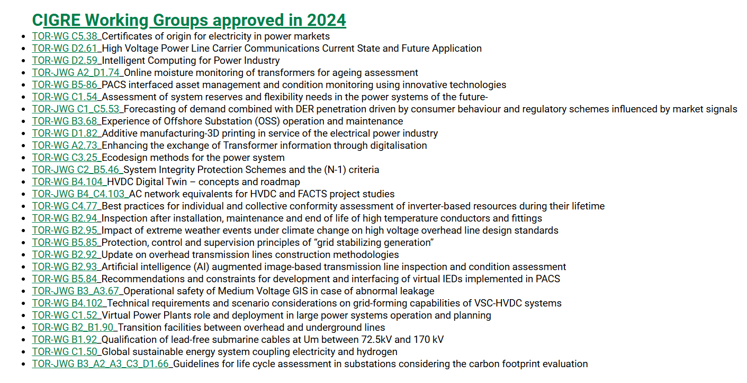
CIGRE Working Groups – The Engine Room
Link to the active working groups :
CIGRE Active Working Groups - Call for Experts
Notes:
There are approximatively 260 CIGRE Working Groups (WG) managed by the Study Committees. Every year between 40 and 50 WGs terminate their work by publishing a Report or a Technical Brochure, after the review and approval of their Study Committees. The Technical Council approves every year almost the same number of new WGs with new Terms of Reference (TOR) proposed by the Study Committees.
If you are interested in becoming a member of one of these Working Groups, please contact your National Committee.

Slide 47
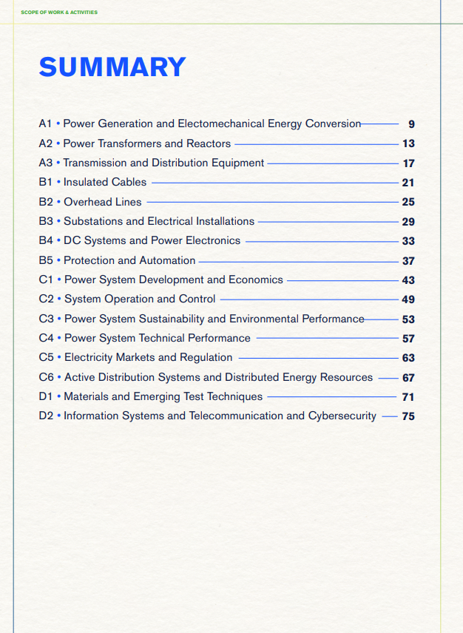
CIGRE – Useful Documents - SOW and Activities
Link to the approved 2024 document as follows :
Scope of Work and Activities Study Commitees 2024

Slide 48
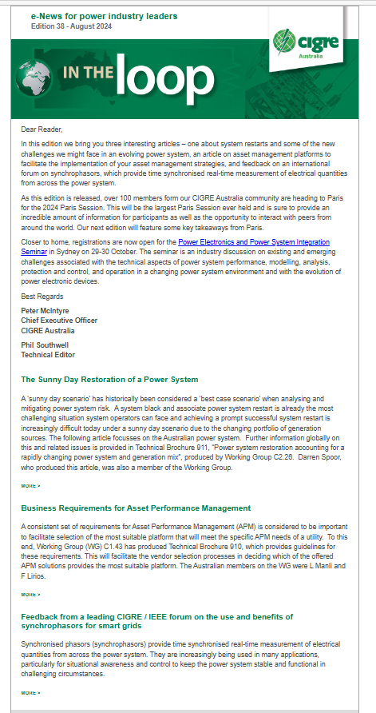
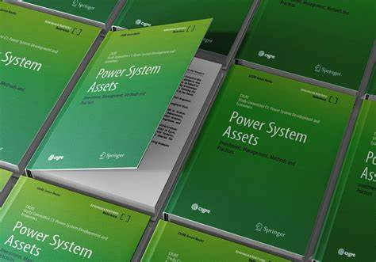
CIGRE resources
Stay connected with our CIGRE publications via :
E-CIGRE – over 15k technical documents and publications
Green Books and Technical Brochures produced by CIGRE Study Committees & Working Groups
Papers produced by CIGRE Technical Working Groups
Paris Session papers and proceedings
Symposia papers and proceedings
Colloquia papers
CIGRE Science and Engineering
Electra and In the Loop publications

Slide 49
Thank you for another successful year
To all our CIGRE member volunteers
To all our Australian panel convenors
To our Study Committee Chairs - Alex Cruickshank and Victor Tan
To the CIGRE Australian Board

Slide 50
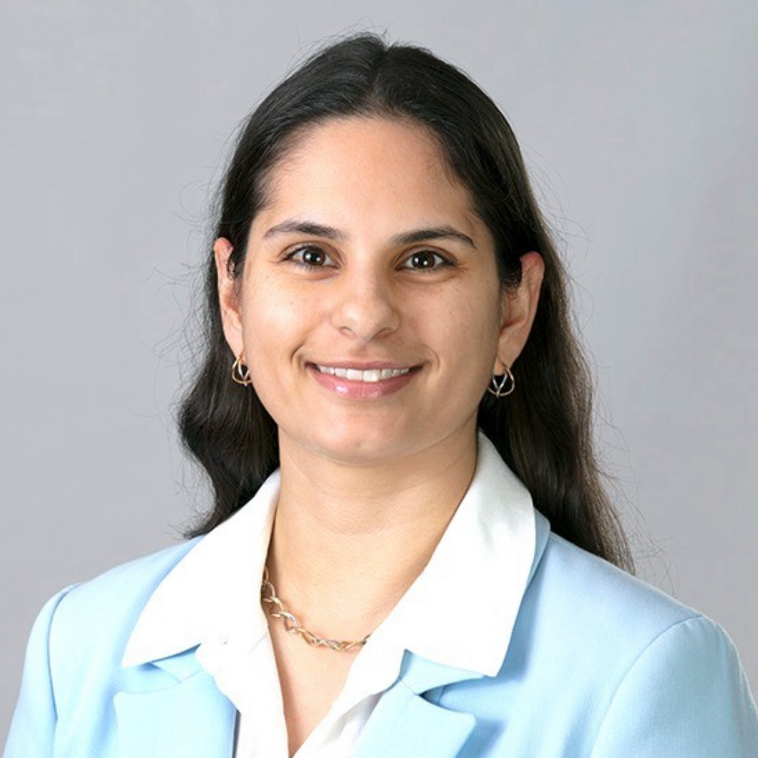
NGN Report
CIGRE Australia AGM – 15 November 2024
Presented by Natasha D’Silva
Co-chair:
Natasha D’Silva
Co-chair:
Adrian Lloyd

Slide 51
2025 NGN Committee
 | Role | NGN Rep | Status
Panel Liaisons | A1: Power Generation and Electromechanical Energy Conversion | Stuart Purcival | Continuing
 | A2: Power Transformers and Reactors | Caolan Griffin | Continuing
 | A3: Transmission and Distribution Equipment | Rex Nii | Continuing
 | B1: Insulated Cables | Pallavi Singh | Continuing
 | B2: Overhead Lines | Phil Coughlan | Incoming
 | B3: Substations and Electrical Installations | Brody Ward | Continuing
 | B4: DC Systems and Power Electronics | Ash Gupta | Continuing
 | B5: Protection and Automation | Owen Gibson | Continuing
 | C1: Power System Development and Economics | Jony Kaushik | Continuing
 | C2: Power System Operation and Control | James Guest | Continuing
 | C3: Power System Sustainability and Environmental Performance | Ellen Power | Continuing
 | C4: Power System Technical Performance | Nina Mohseni | Continuing
 | C5: Electricity Markets and Regulation | Cassandra Ma | Continuing
 | C6: Active Distribution Systems and Dispersed Energy Resources | Pat Graham | Continuing
 | D1: Materials and Emerging Test Techniques | Reghan Skerman | Incoming
 | D2: Information Systems, Telecommunications and Cybersecurity | Avisa Agustina | Incoming
Inter-Group Liaisons | ATC Secretary | Natasha D’Silva | Continuing
 | Study Committee | Nathan Crooks | Continuing
 | API* | Neha Moturi | Continuing
 | IEEE | Steve Oag | Continuing
Coordinators | Publishing | Kunj Thekdi Lin Zeng | Continuing Continuing
 | Membership Engagement | Owen Gibson Sam Cox | Continuing Incoming
 | Mentoring* | Mitchel Tap | Continuing
 | Digital Media | Wei Jian Chan | Continuing
CIGRE Australia
Co-Chairs
Australian Panel Liaisons
Inter-Group Liaisons
Publishing Coordinator
Mentoring Coordinator
CIGRE Australia NGN
A1
ATC
Membership Engagement Coordinator
Digital Media Coordinator
IEEE
API
D2
Study Committee
*Position under review
Thank you to our outgoing committee members:
Stephanie Phillips (B2)
Sam Murali (D1)
Mark Mathews (D2)
Notes:
Change from last year – Mentoring Coordinator has been appointed.
11 changes post AGM this year. More on that later.

Slide 52
NGN Australia 2024: Report Card & Membership Update
Strategic Report Card
Continual, steady membership growth
349 Registered NGN Members
14% increase on 2023 (6% below target)
7% students, +12 members (8% below target)
Prepare for the 2024 Paris Session
Two NGN AU presenters selected to present at the NGN Showcase
NGN Australia organised and hosted the NGN Forum
Continue to pursue ways to better engage and involve our broader NGN membership
NGN Mirror Panel Observer Program scoped (launching 2025)
Digital platform refresh scoped (launching 2025)
Review and revise mentor program
NextGen Development Program recommendations prepared for CIGRE Australia board
Continue facilitating technical webinars
6 webinars delivered

Slide 53
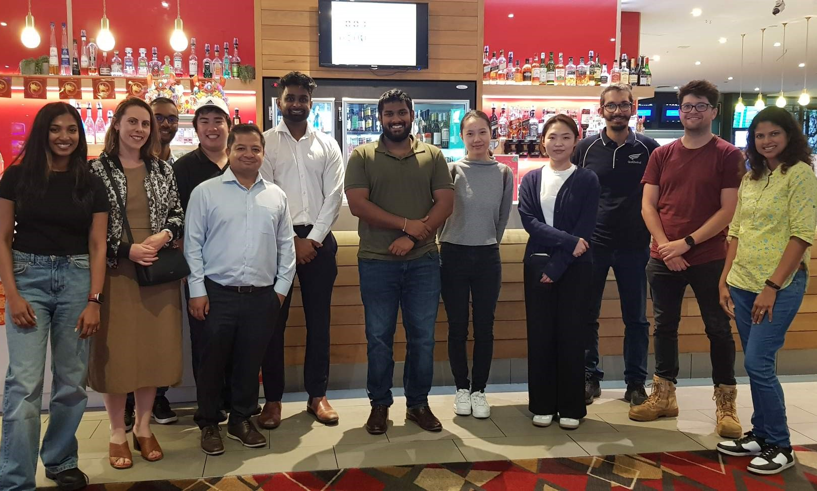
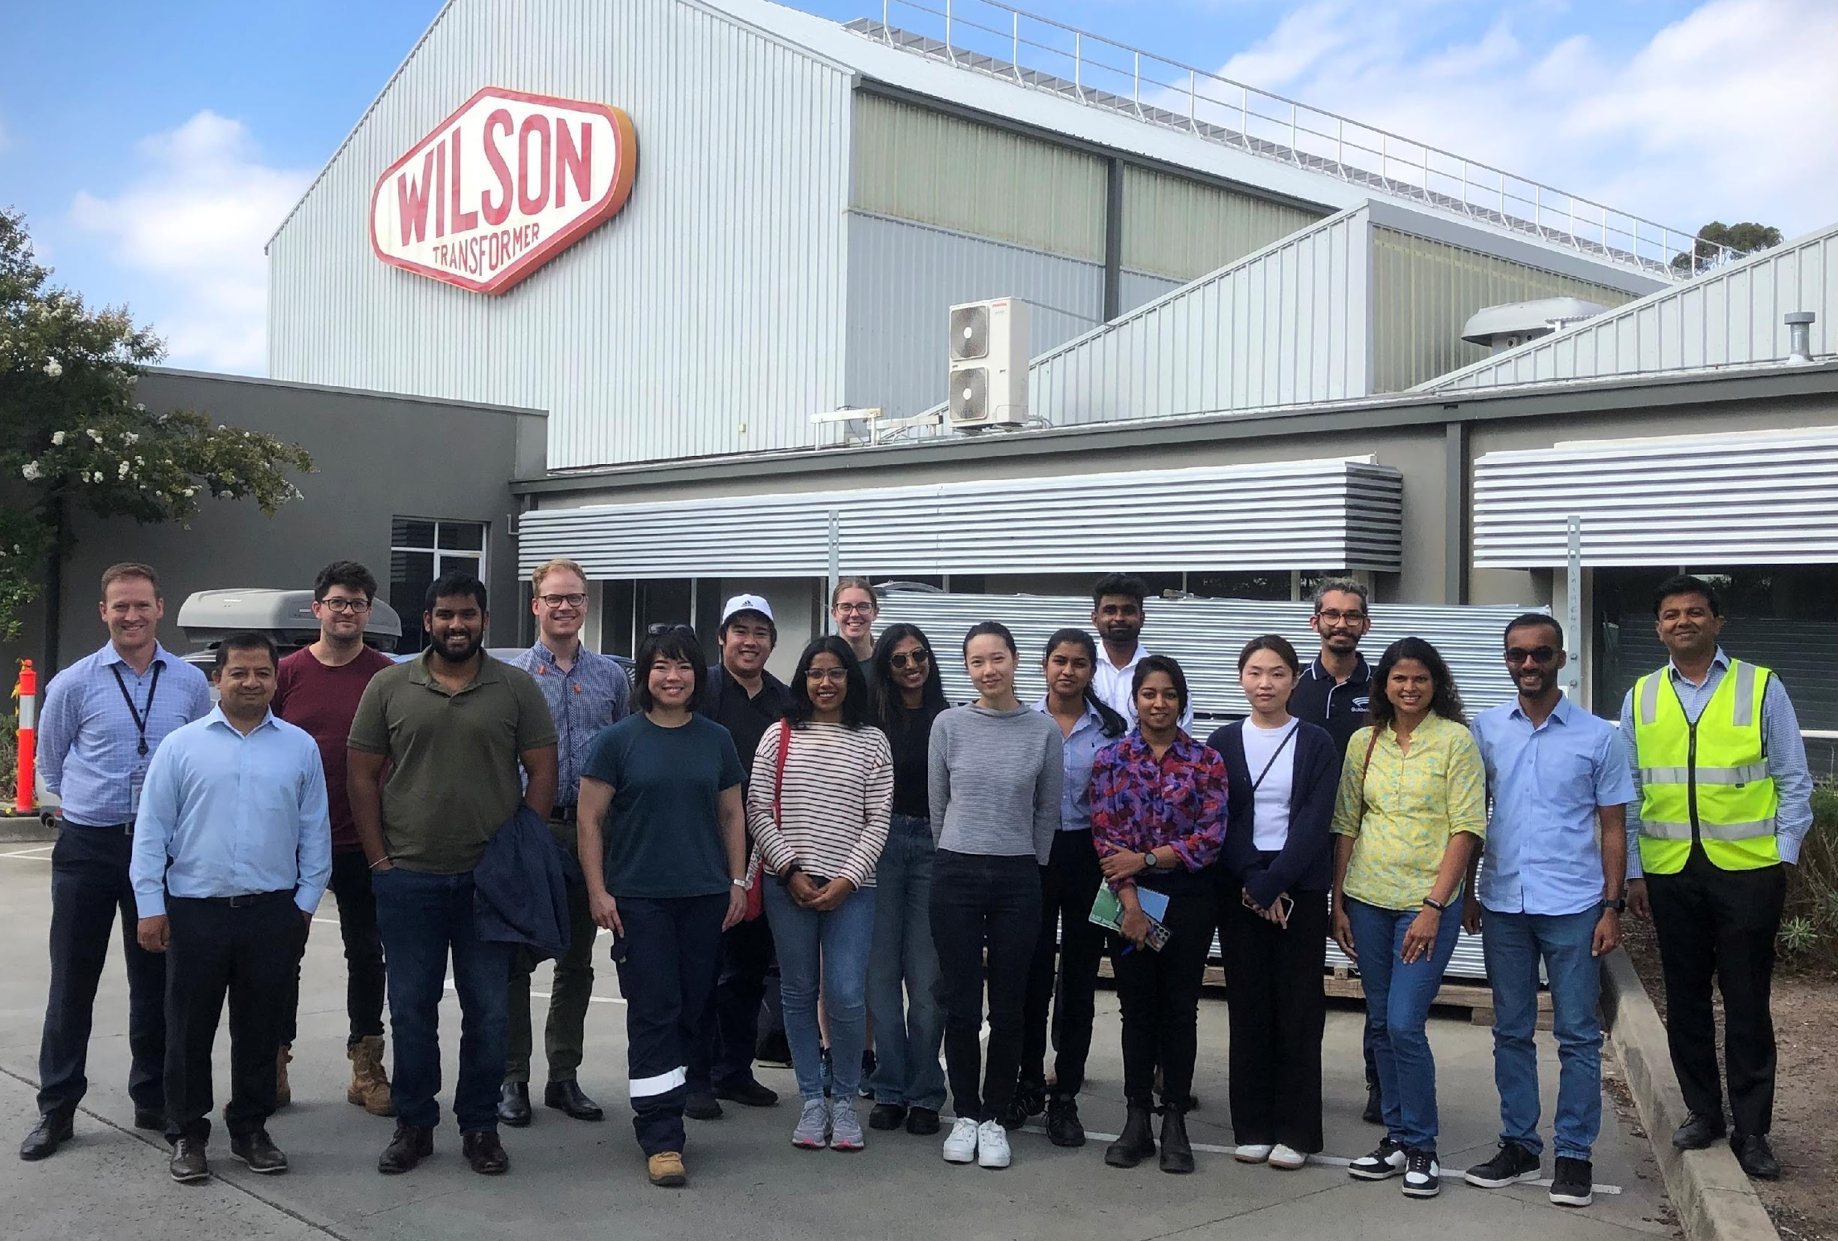
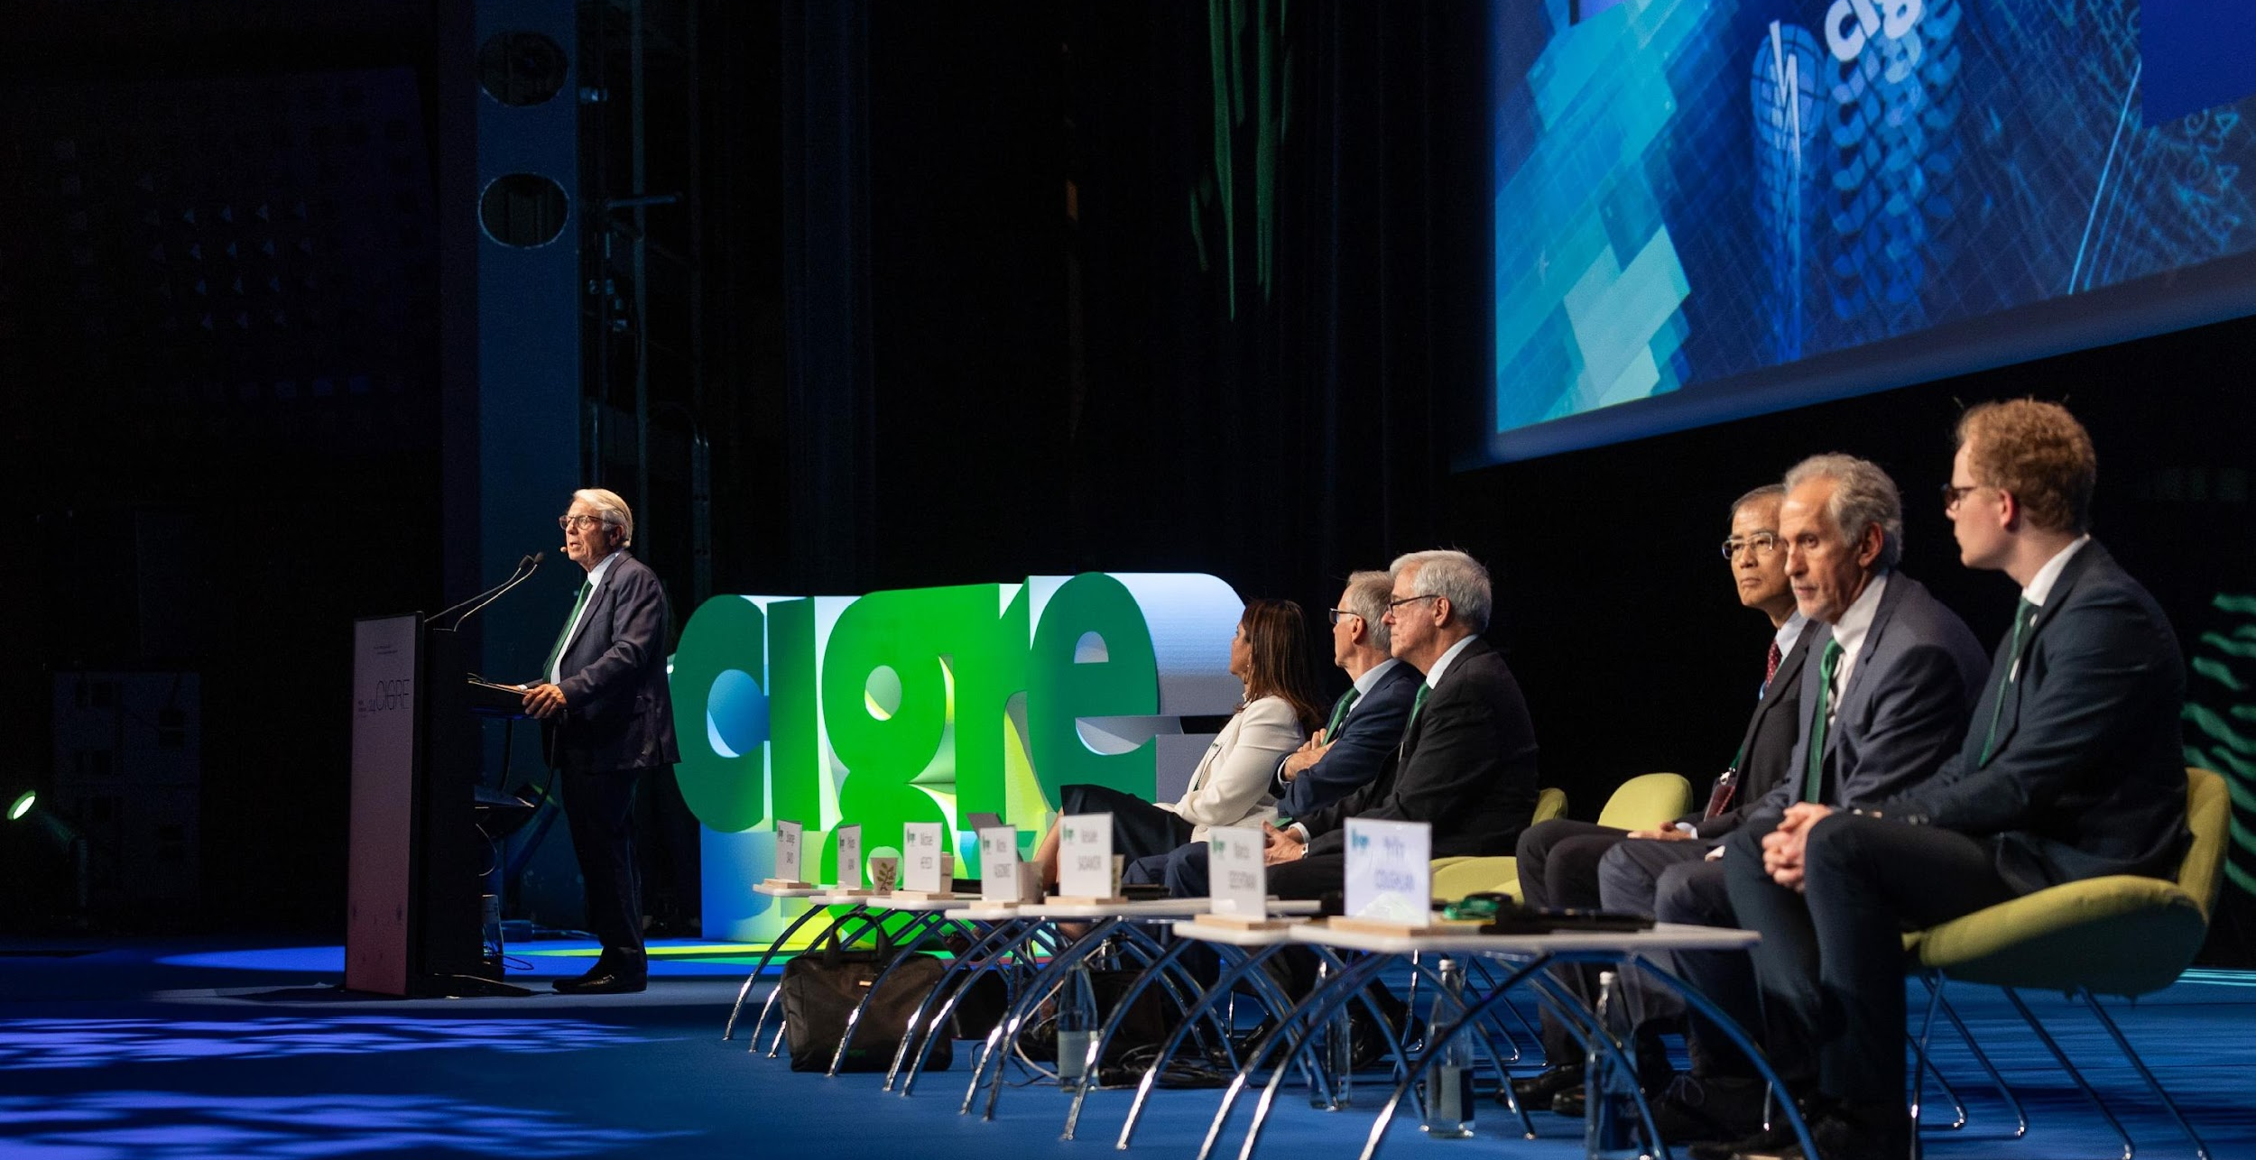
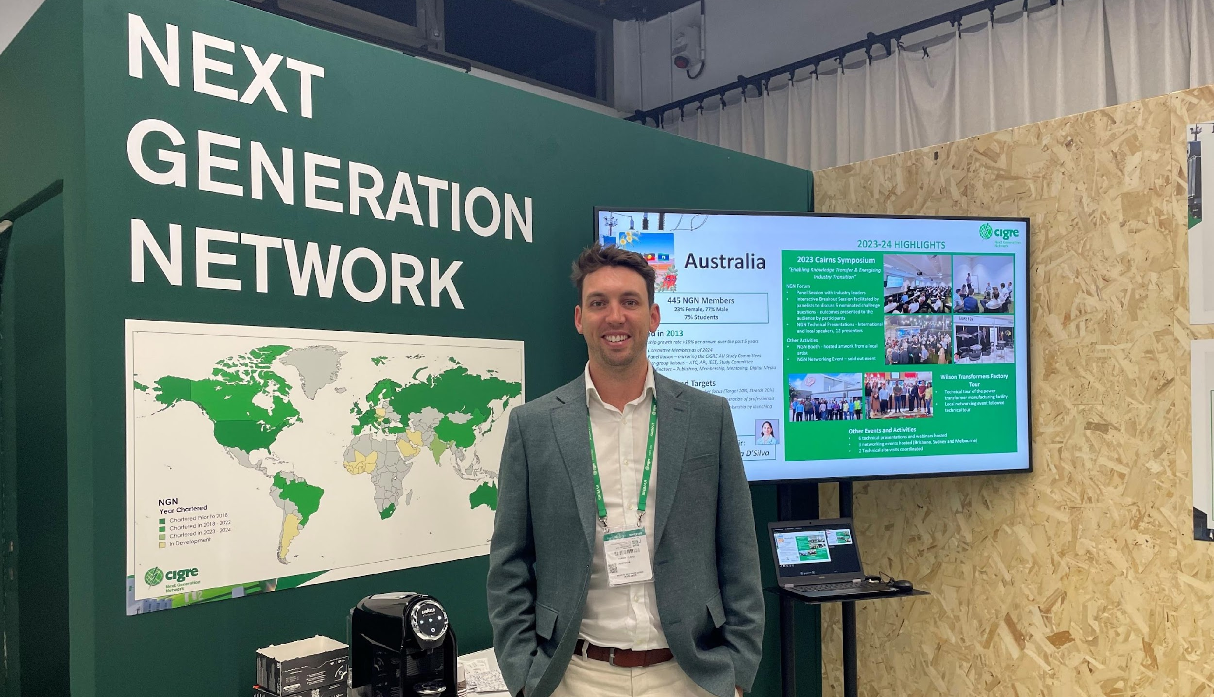
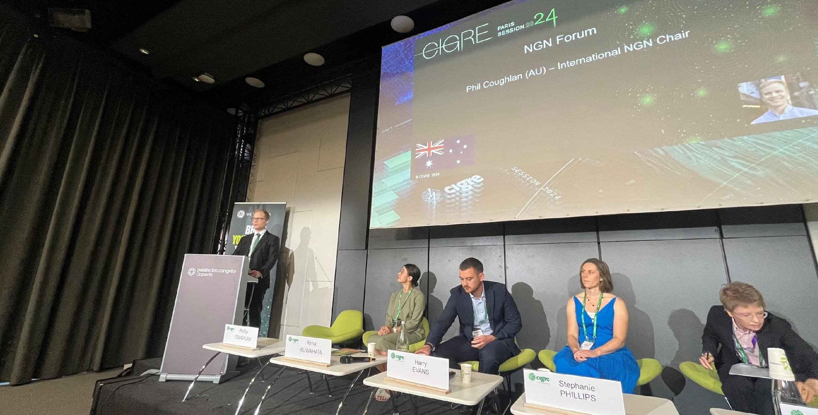
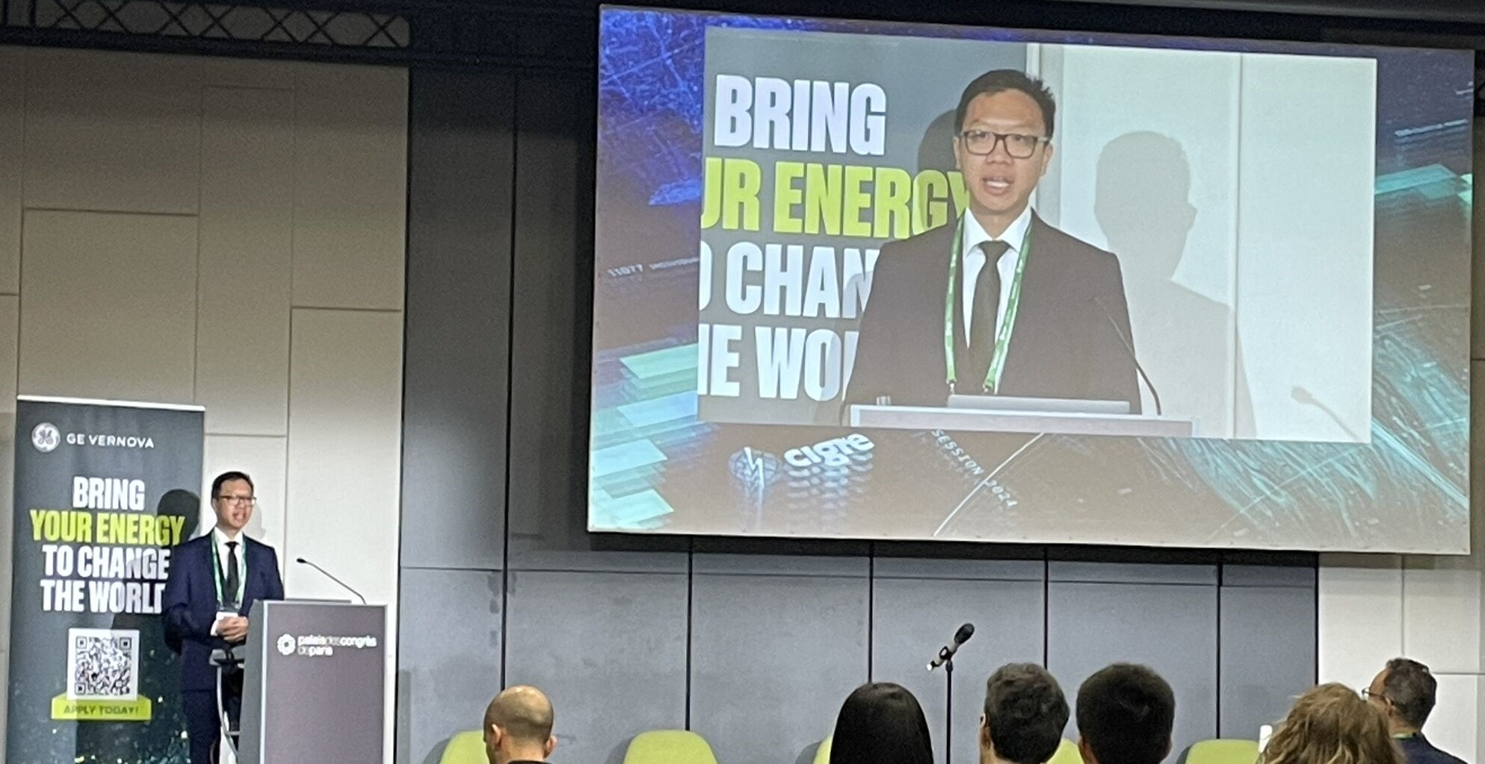
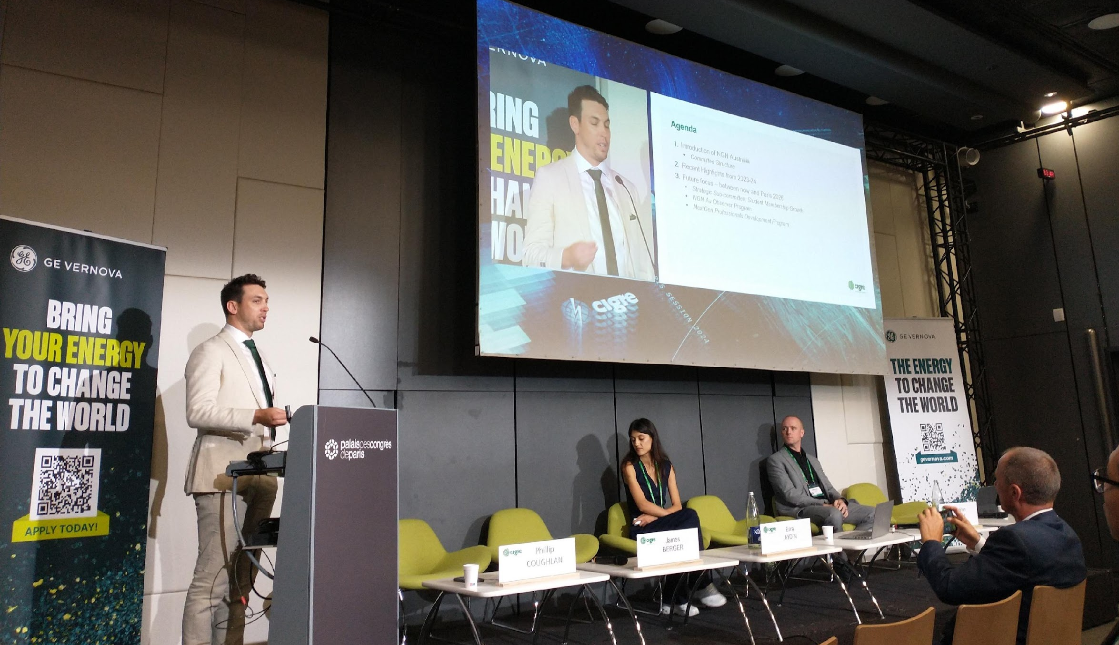
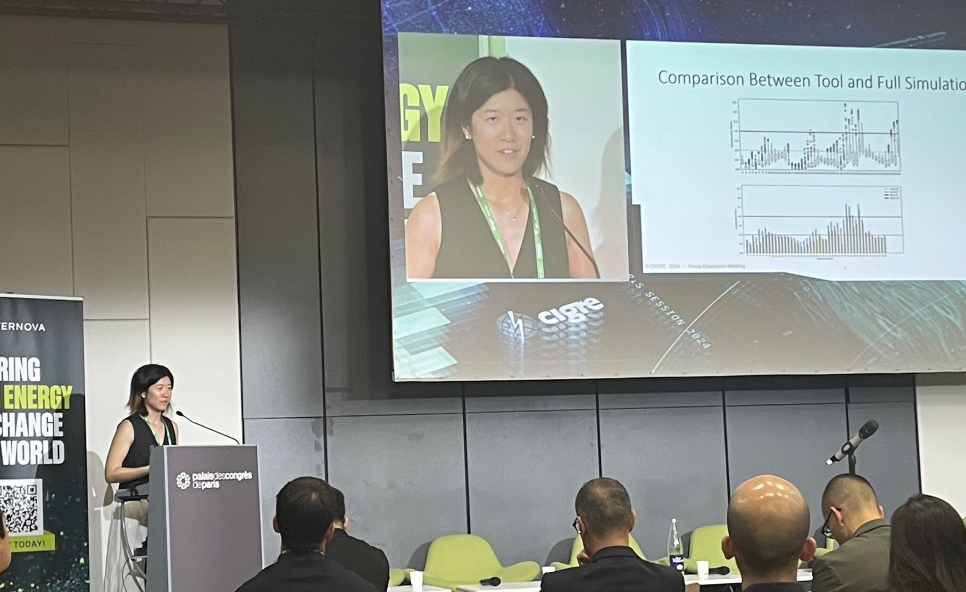
NGN Australia Events 2024
Online Events
6 webinars hosted across various streams
Technical Essentials
Technical Deep Dives
NGN updates
Local Events
Melbourne & Brisbane networking events
Wilson Transformers site tour
Spotlight on CIGRE Paris 2024
The 2024 NGN Forum was hosted by NGN Australia
6 NGN AU members presented in various forums
Excellent engagement with other NGN chapters
Notes:
Note that all NGN/WiE webinar and event details are posted on the NGN website, and all of the past NGN webinars detailed above were posted as recordings in the NGN KMS space and on the CIGRE YouTube channel.

Slide 54
Looking ahead to 2025
Continual, steady membership growth – Target 20%, Stretch 30%
Ramp up student member growth – Target +40 students, Stretch +60 students
Launch Mirror Panel Observer Program
Launch NextGen Professional Development Program(s)
Continue to facilitating technical webinars – Target 8, Stretch 10
Continue to organise networking events for NGN members – Target 4, Stretch 6
Increase engagement and activity with international NGN chapters
Refresh the NGN Digital Platforms
Refresh NGN website content and integrate with CIGRE Australia site
Develop and launch a new members only online portal
Refresh the NGN KMS space
Launch an NGN AU LinkedIn
Review and update NGN membership registration – remove KMS barrier
Review and update the NGN Australia Charter
Notes:
Face-to-face catchups – Paris.

Slide 55
Thank you

